Slide 2
Implementations & Analysis of Adaptive FIR, IIR and Lattice Structures
Cui Ao, Xu Yuanyuan and Wang Li (Ahmed)

Slide 3
Contents
Adaptive FIR Structure
Adaptive IIR Structure
Adaptive Lattice Structure
Simple Applications

Slide 4
CHAP 1 Adaptive FIR Structure
LMS Algorithm
LMS/Newton Algorithm
SER Algorithm
Comparisons & Summary

Slide 5
1-1 FIR LMS Algorithm

Slide 6
FIR| LMS——Theoretical Derivation
SDM:
KEY POINT
Considering:

Slide 7
FIR| LMS——Theoretical Derivation
Where
Thus
Unbiased Estimator

Slide 8
FIR| LMS——Theoretical Derivation
Where we can arrive at LMS algorithm
LMS:

Slide 9
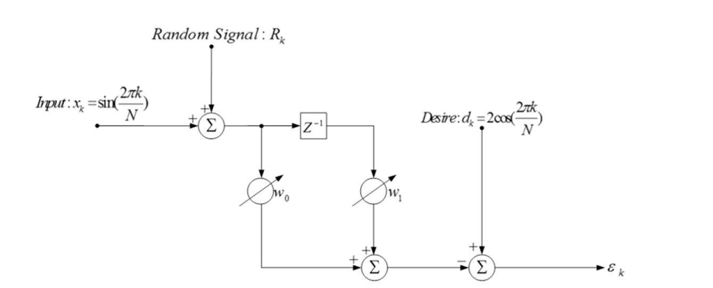
FIR| LMS——Simulation
Fig 1-1-1, A 2-weight Adaptive FIR,
N=16, Random Signal is a Gaussian White Noise with its power = 0.01

Slide 10
FIR| LMS——Flow Chart
FIR_LMS.m
Script

Slide 11
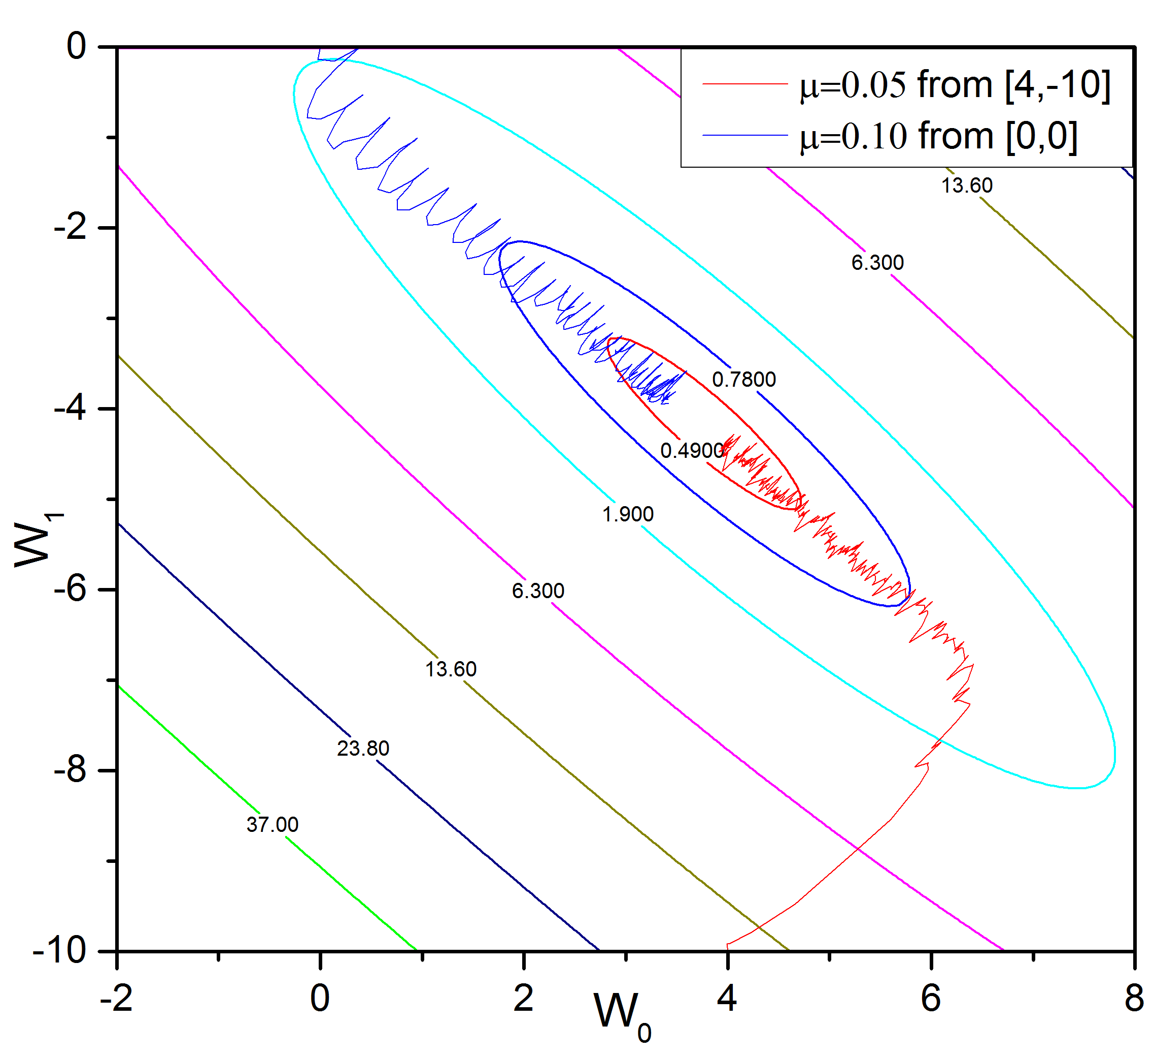
FIR| LMS——Simulation Results
Fig 1-1-2, Weights Adapting Procedure using LMS

Slide 12
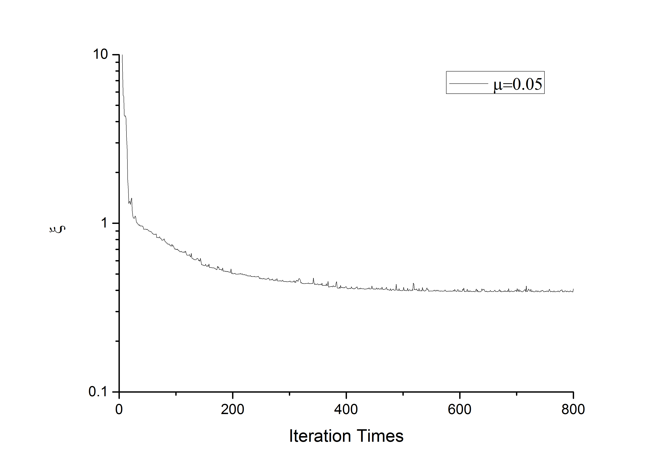
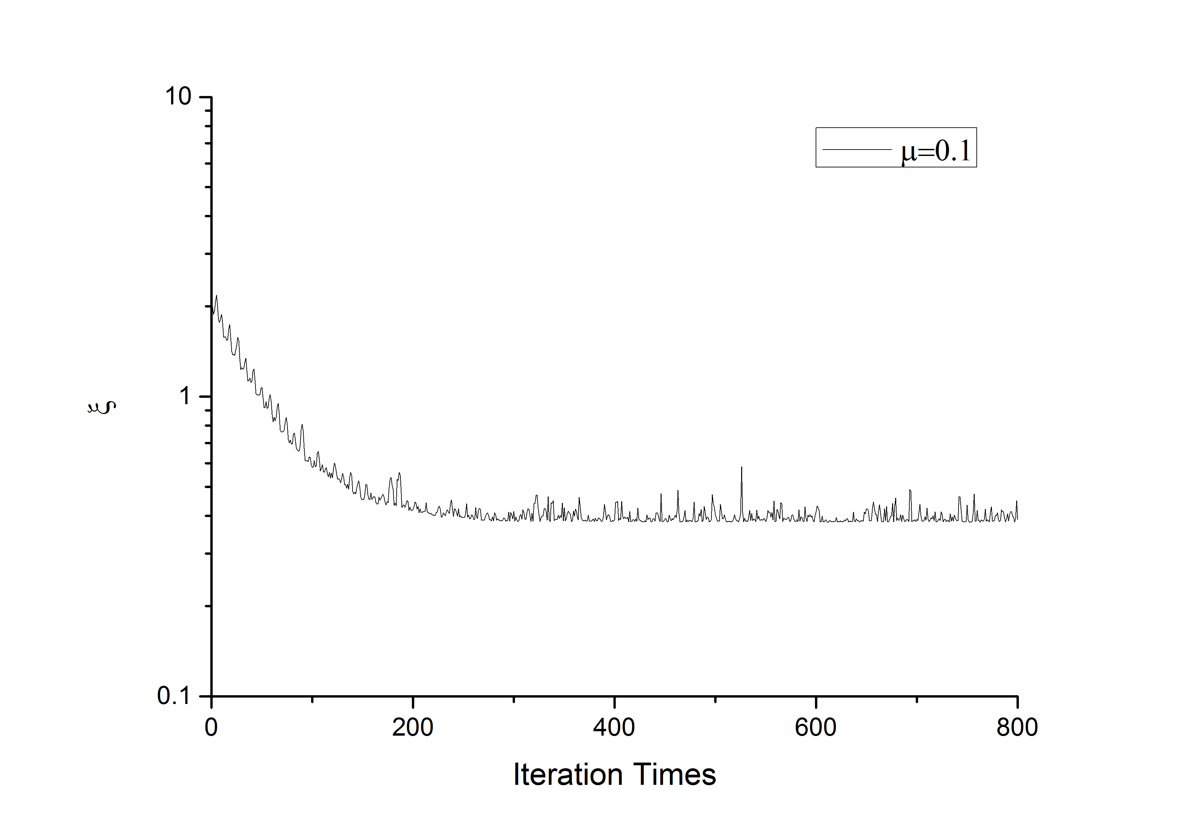
FIR| LMS——Simulation Results
Fig 1-1-3, Learning Curves

Slide 13
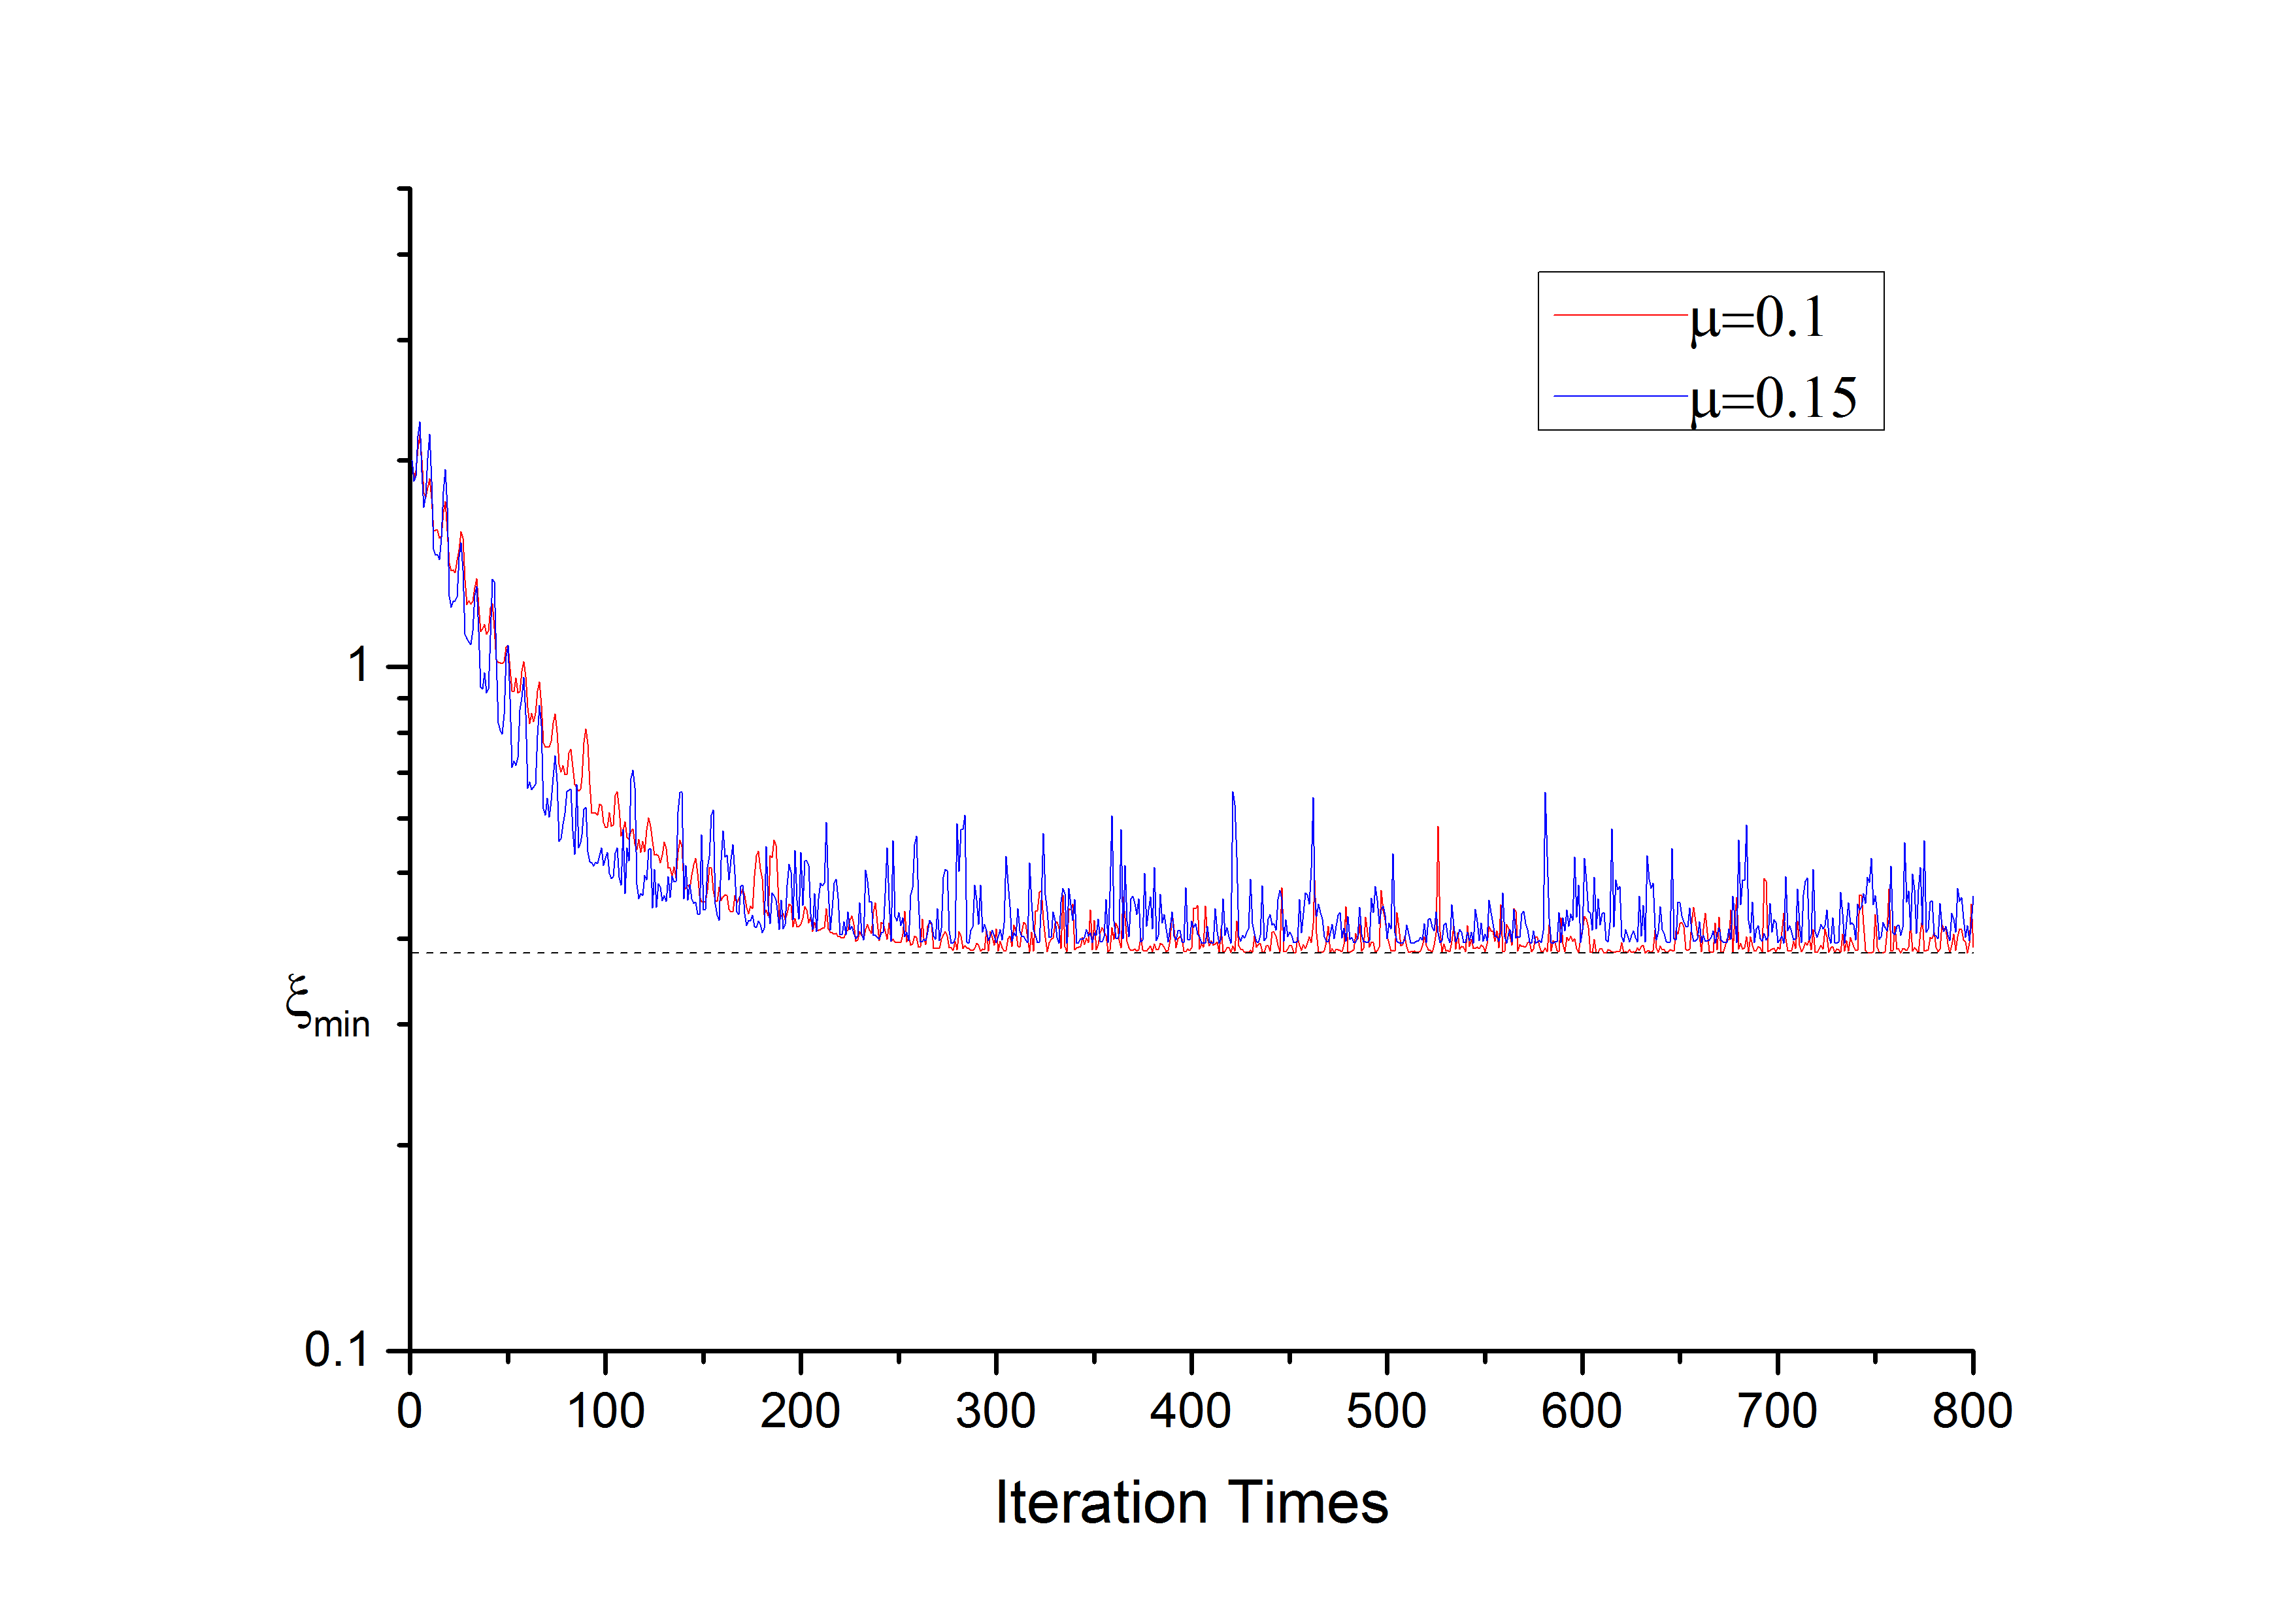
FIR| LMS——Simulation Results
Fig 1-1-4, Learning Curves of starting from [0,0] in different step length

Slide 14
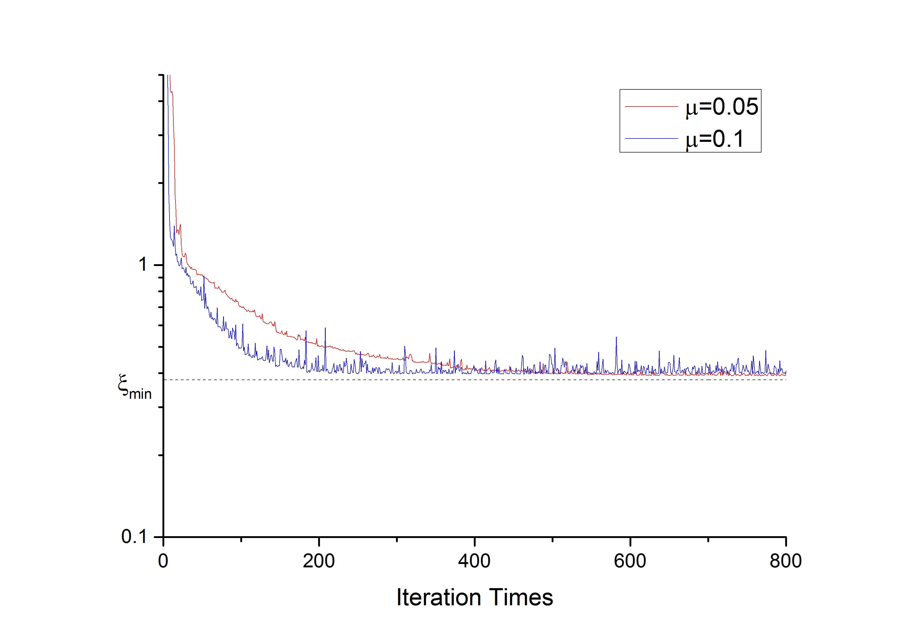
FIR| LMS——Simulation Results
Fig 1-1-5, Learning Curves of starting from [4,-10] in different step length

Slide 15
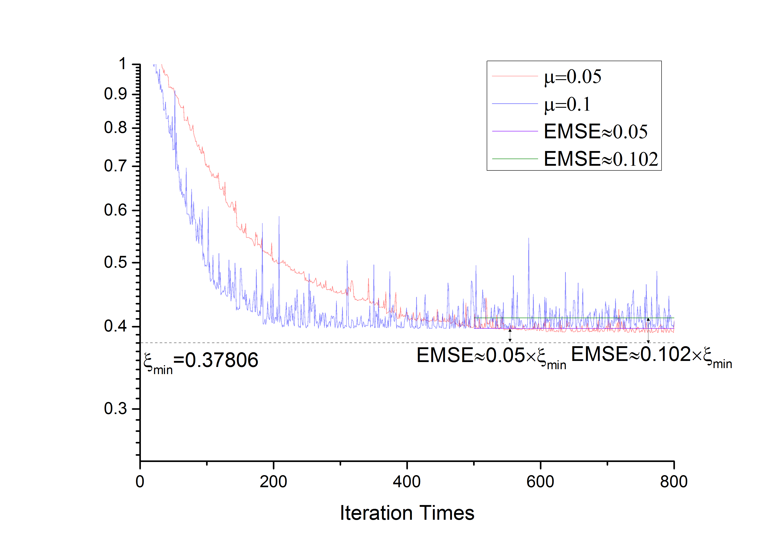
FIR| LMS——Simulation Results
Fig 1-1-6, Detailed Learning Curves of starting from [4,-10] in different step length

Slide 16
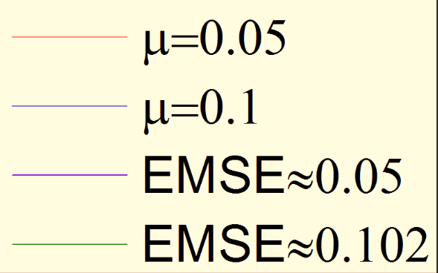
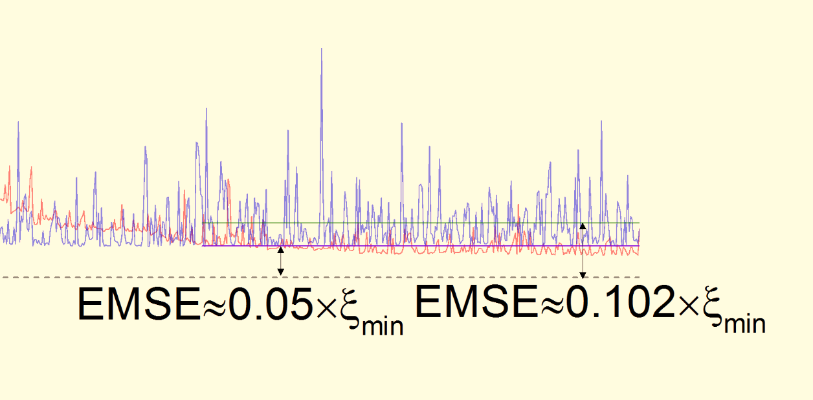
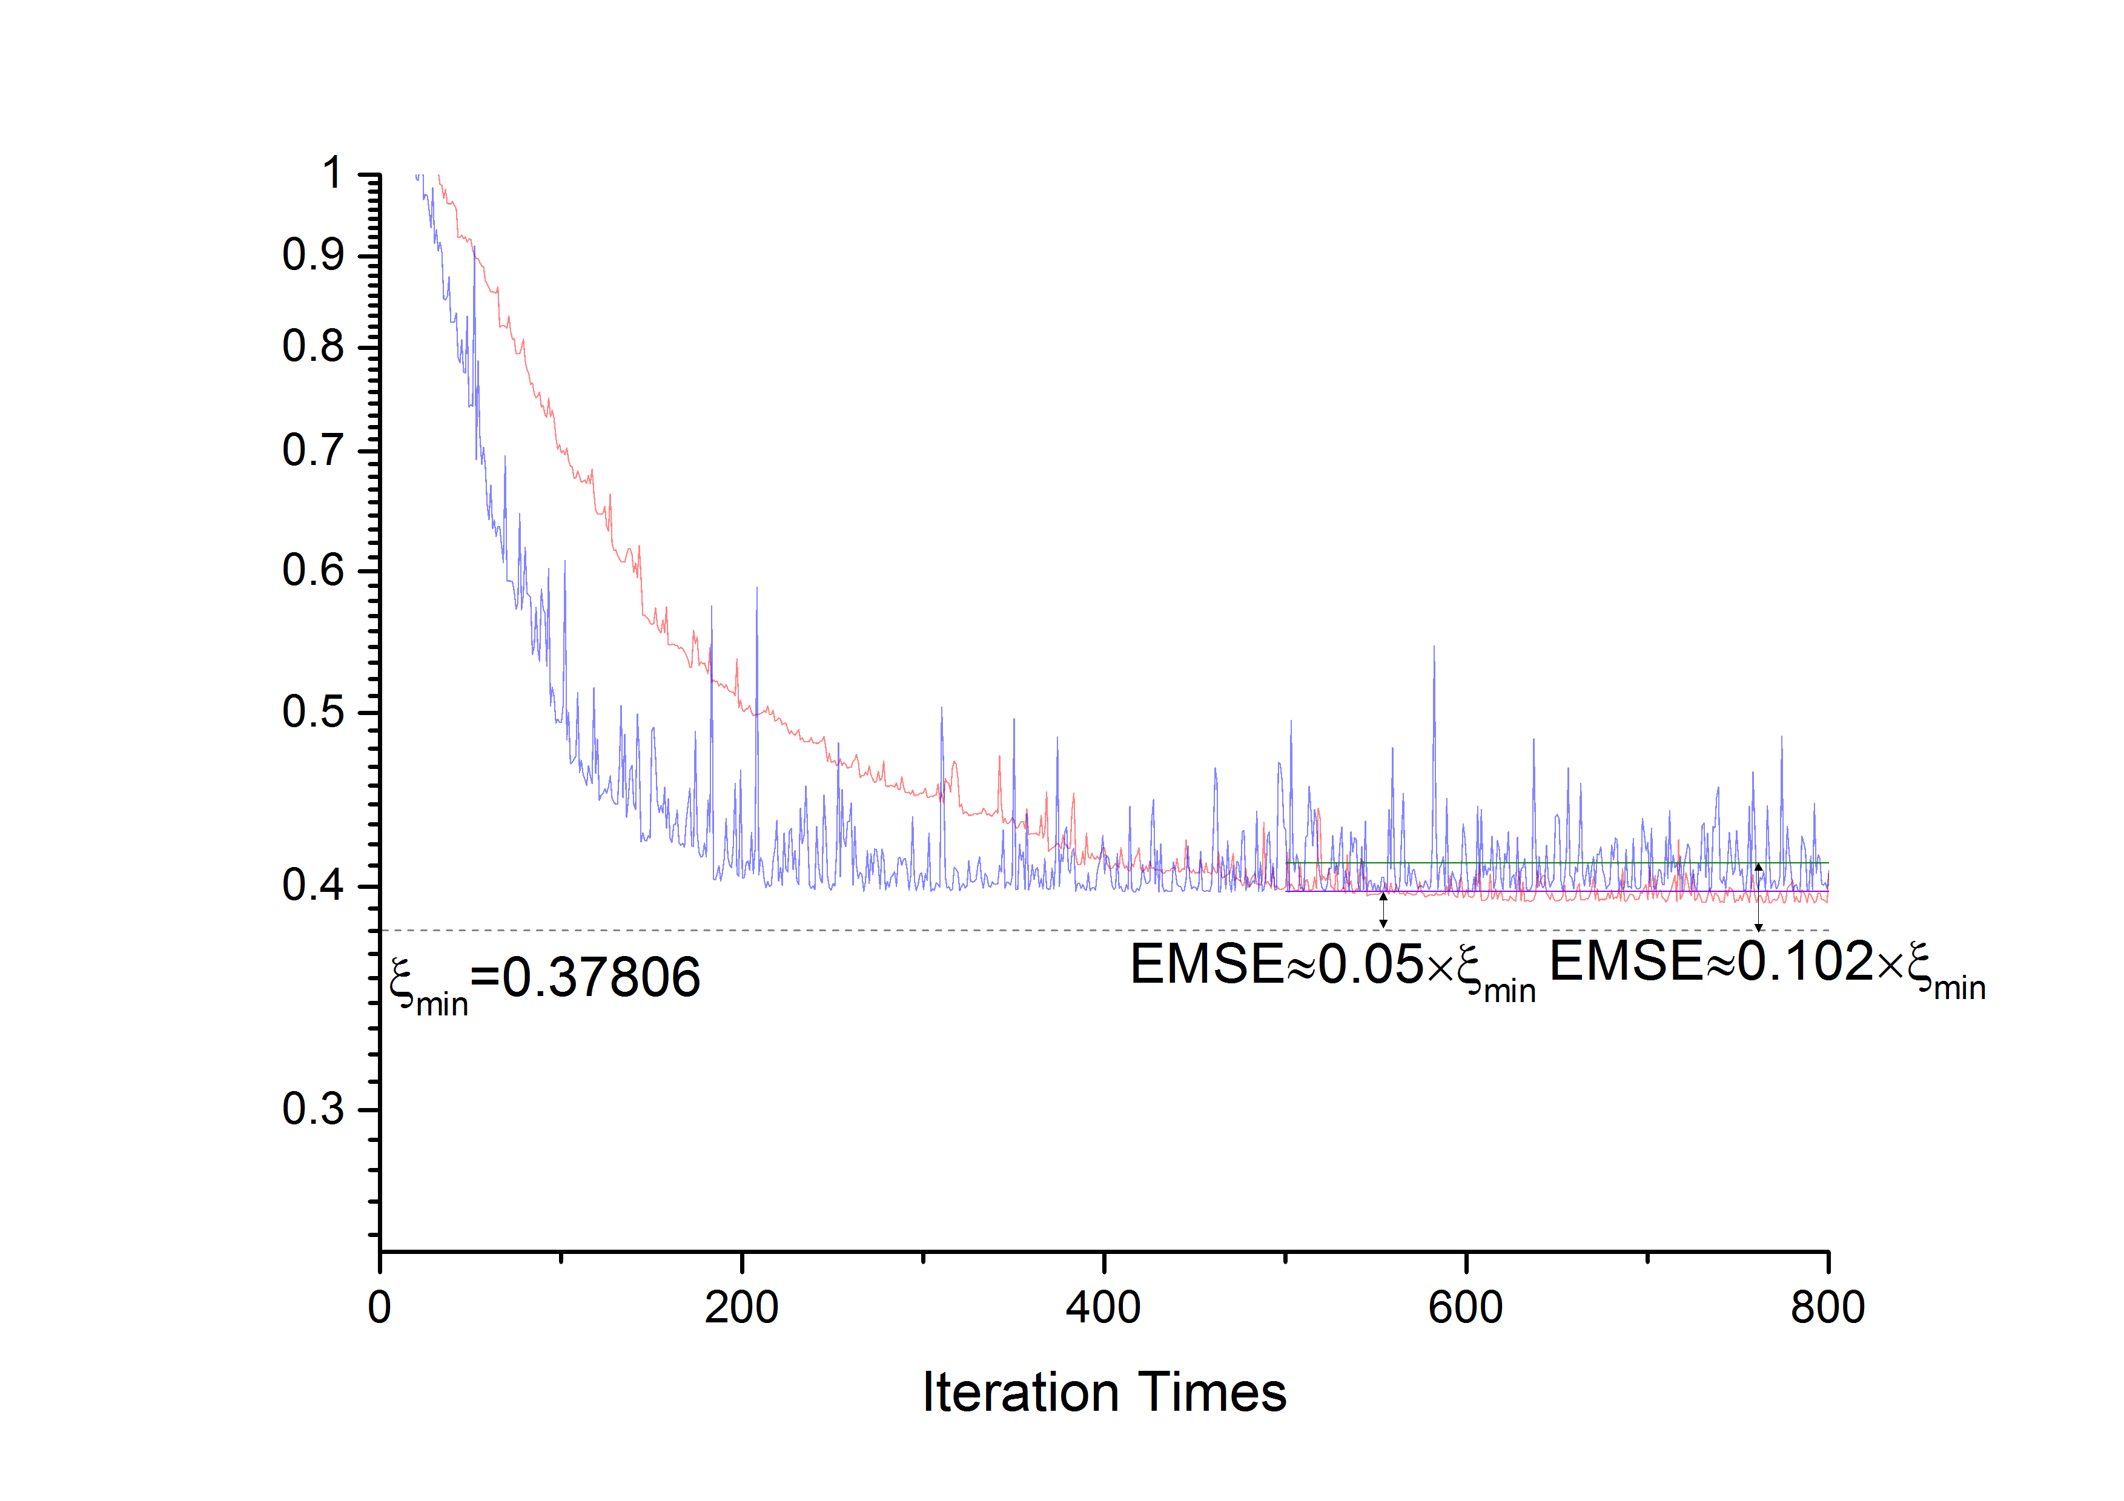
FIR| LMS——Simulation Results

Slide 17
FIR| LMS——Simulation Results
For μ=0.05:
For μ=0.1:

Slide 18
1-2 FIR LMS/Newton Algorithm

Slide 19
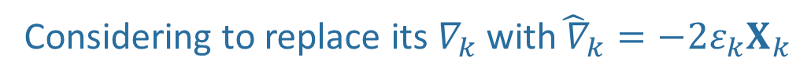

FIR| LMS/Newton——Theoretical Derivation
NM:
Considering to replace its $∇_{k}$with${\hat{ ∇}}_{k}=−2ε_{k}X_{k}$
And regard$μλ_{AV} as a$ scale factor.
we will arrive at
LMS/Newton:

Slide 20
FIR| LMS/Newton——Simulation
Fig 1-2-1, A 2-weight Adaptive FIR,
N=16, Random Signal is a Gaussian White Noise with its power = 0.01

Slide 21
FIR| LMS/Newton——Flow Chart
FIR_LMSNewton.m
Script

Slide 22
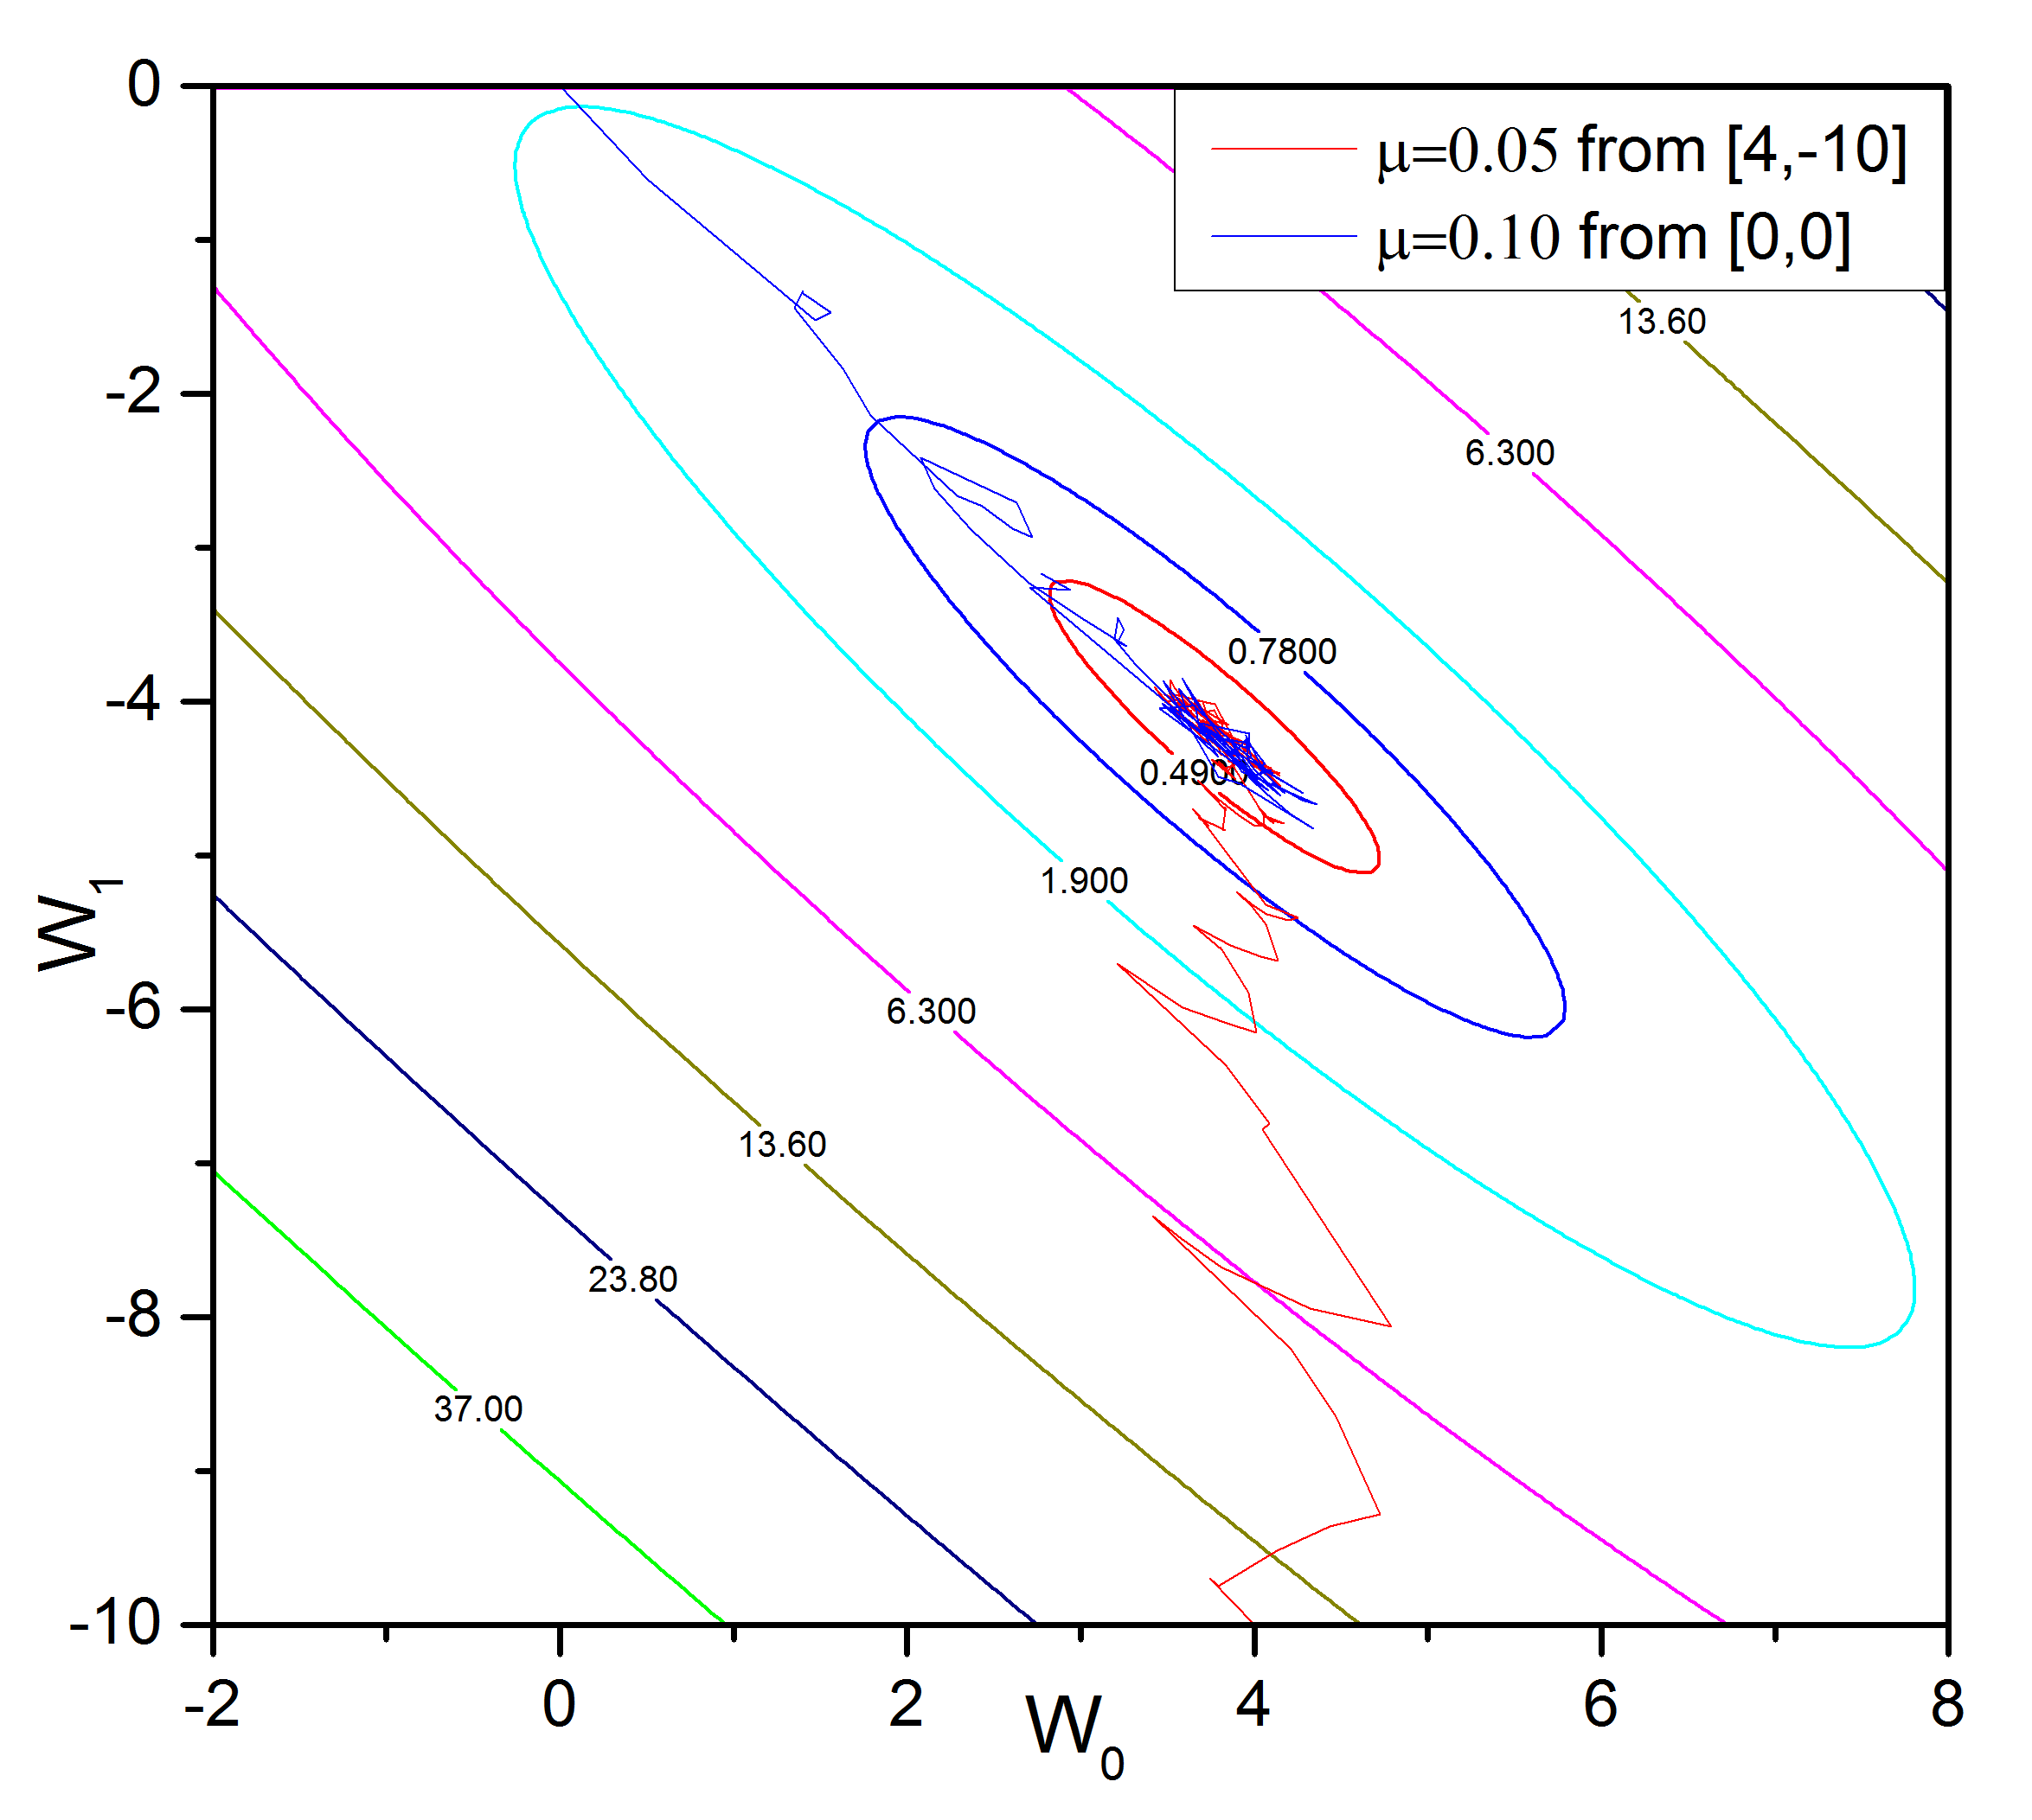
FIR| LMS/Newton——Simulation Results
Fig 1-2-2, Weights Adapting Procedure using LMS/Newton

Slide 23
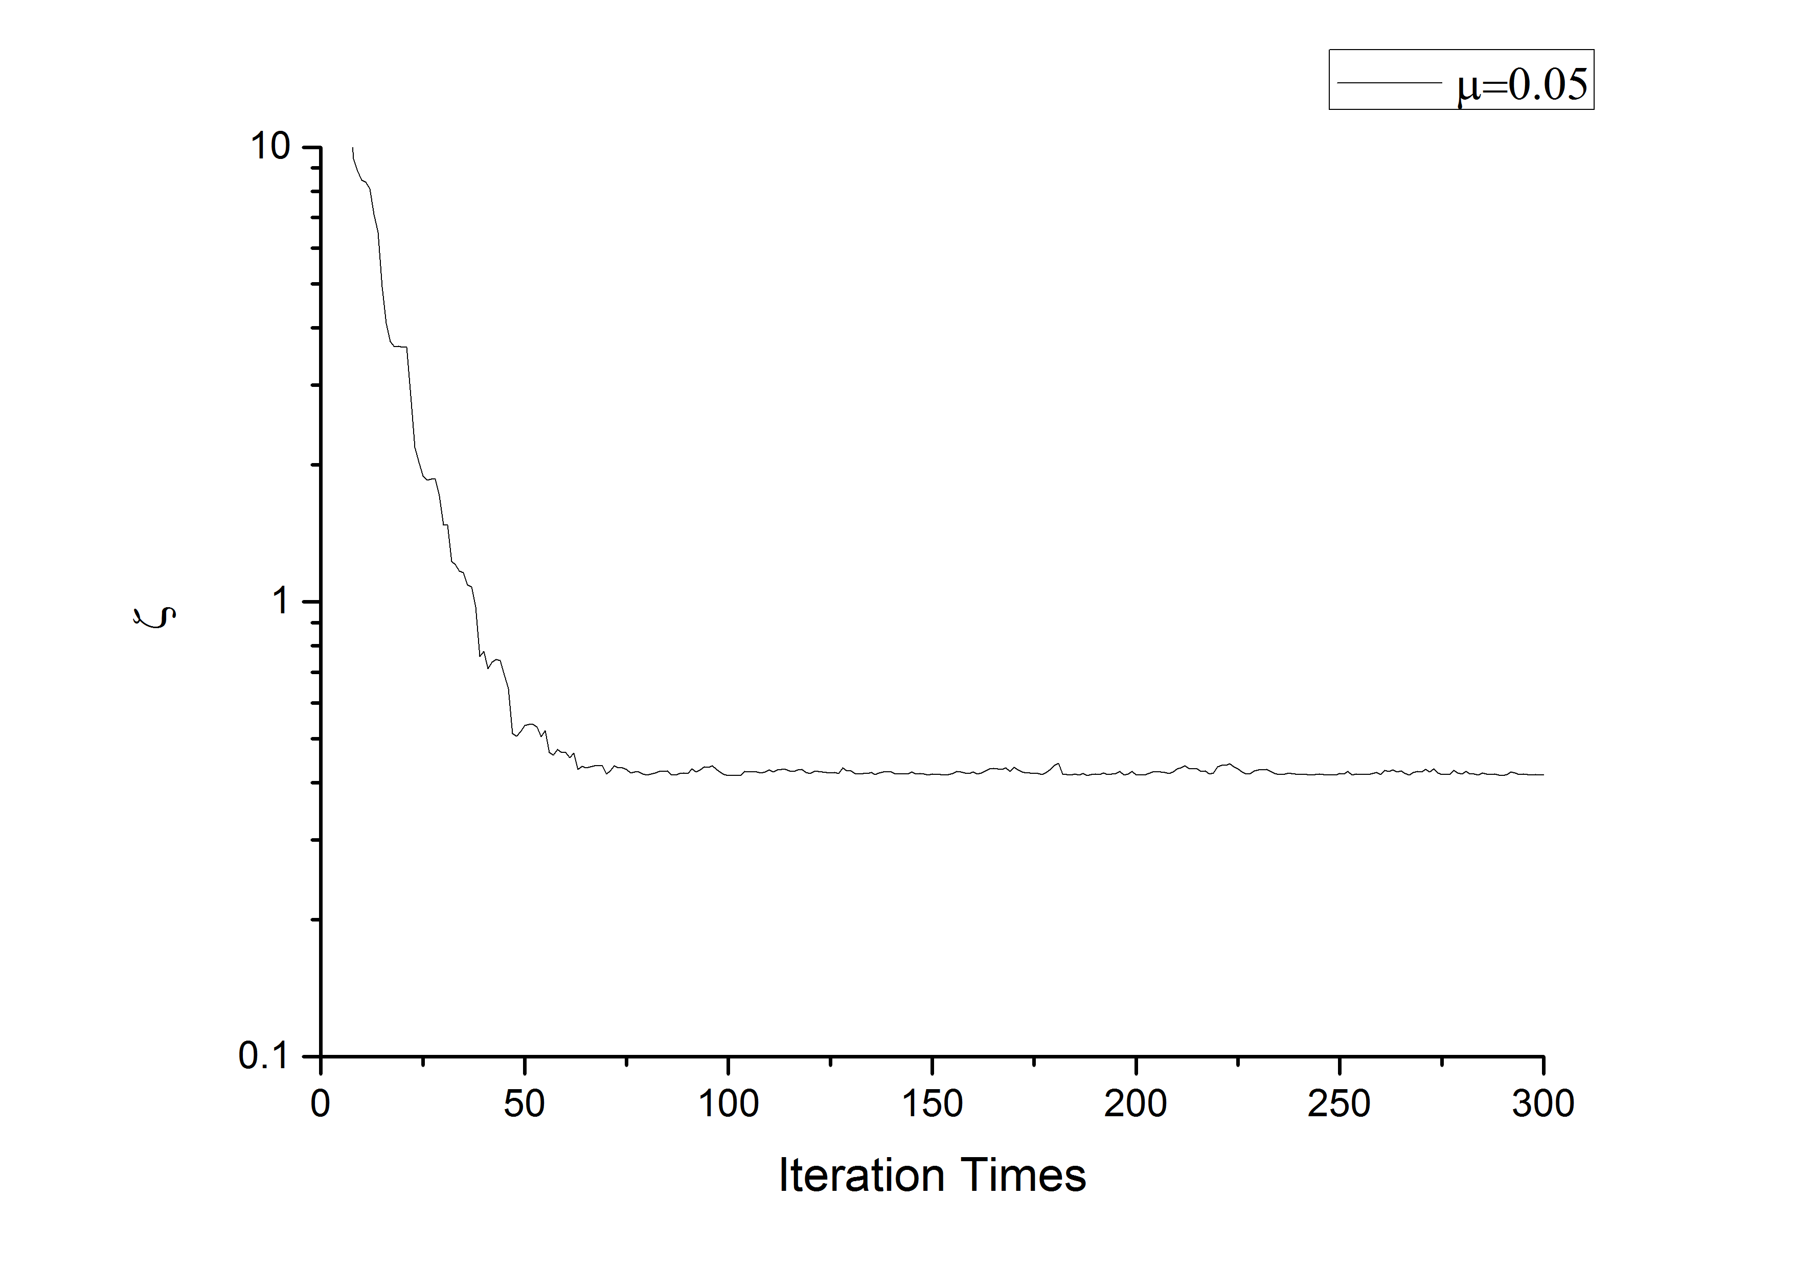

FIR| LMS/Newton——Simulation Results
Fig 1-2-3, Learning Curves

Slide 24
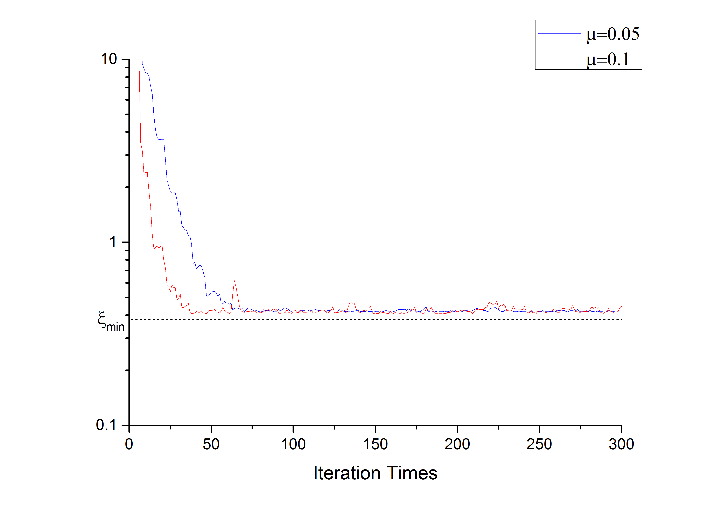
FIR| LMS/Newton——Simulation Results
Fig 1-2-4, Learning Curves of starting from [4,-10] in different step length

Slide 25
1-3 FIR SER Algorithm

Slide 26
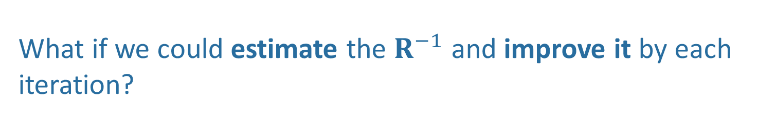

FIR| SER——Theoretical Derivation
LMS/Newton:
Good but Unattainable
We have seen $R^{−1}$allows $W$ to take the direct path rather than the path of SDM.
Also a KEY POINT!
What if we could estimate the $R^{−1}$ and improve it by each iteration?

Slide 27
FIR| SER——Theoretical Derivation
Under stationary conditions & finite number of 𝐗
Unbiased Estimator
When 𝐗 is non-stationary, which is more realistic, we could provide a short term memory in the estimate of 𝐑 by using:
Memory Factor

Slide 28
FIR| SER——Theoretical Derivation
Memory Factor
Normally

Slide 29
FIR| SER——Theoretical Derivation
Thus, at the k_{th} iteration

Slide 30
FIR| SER——Theoretical Derivation
Also assume
We also have

Slide 31
FIR| SER——Theoretical Derivation
We will arrive at
Then

Slide 32
FIR| SER——Theoretical Derivation
Finally

Slide 33
FIR| SER——Theoretical Derivation
Finally
Put it into LMS/Newton

Slide 34
FIR| SER——Theoretical Derivation
Also

Slide 35
FIR| SER——Theoretical Derivation
FIR
SER
Initiation

Slide 36
FIR| SER——Theoretical Derivation
Following
Iterations

Slide 37
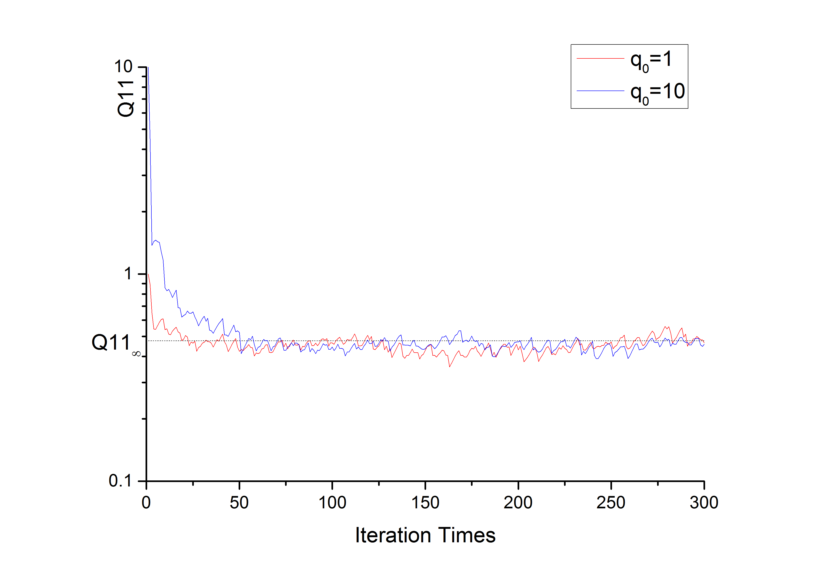
FIR| SER——Theoretical Derivation
Fig 1-3-1, Convergence of Q11,

Slide 38
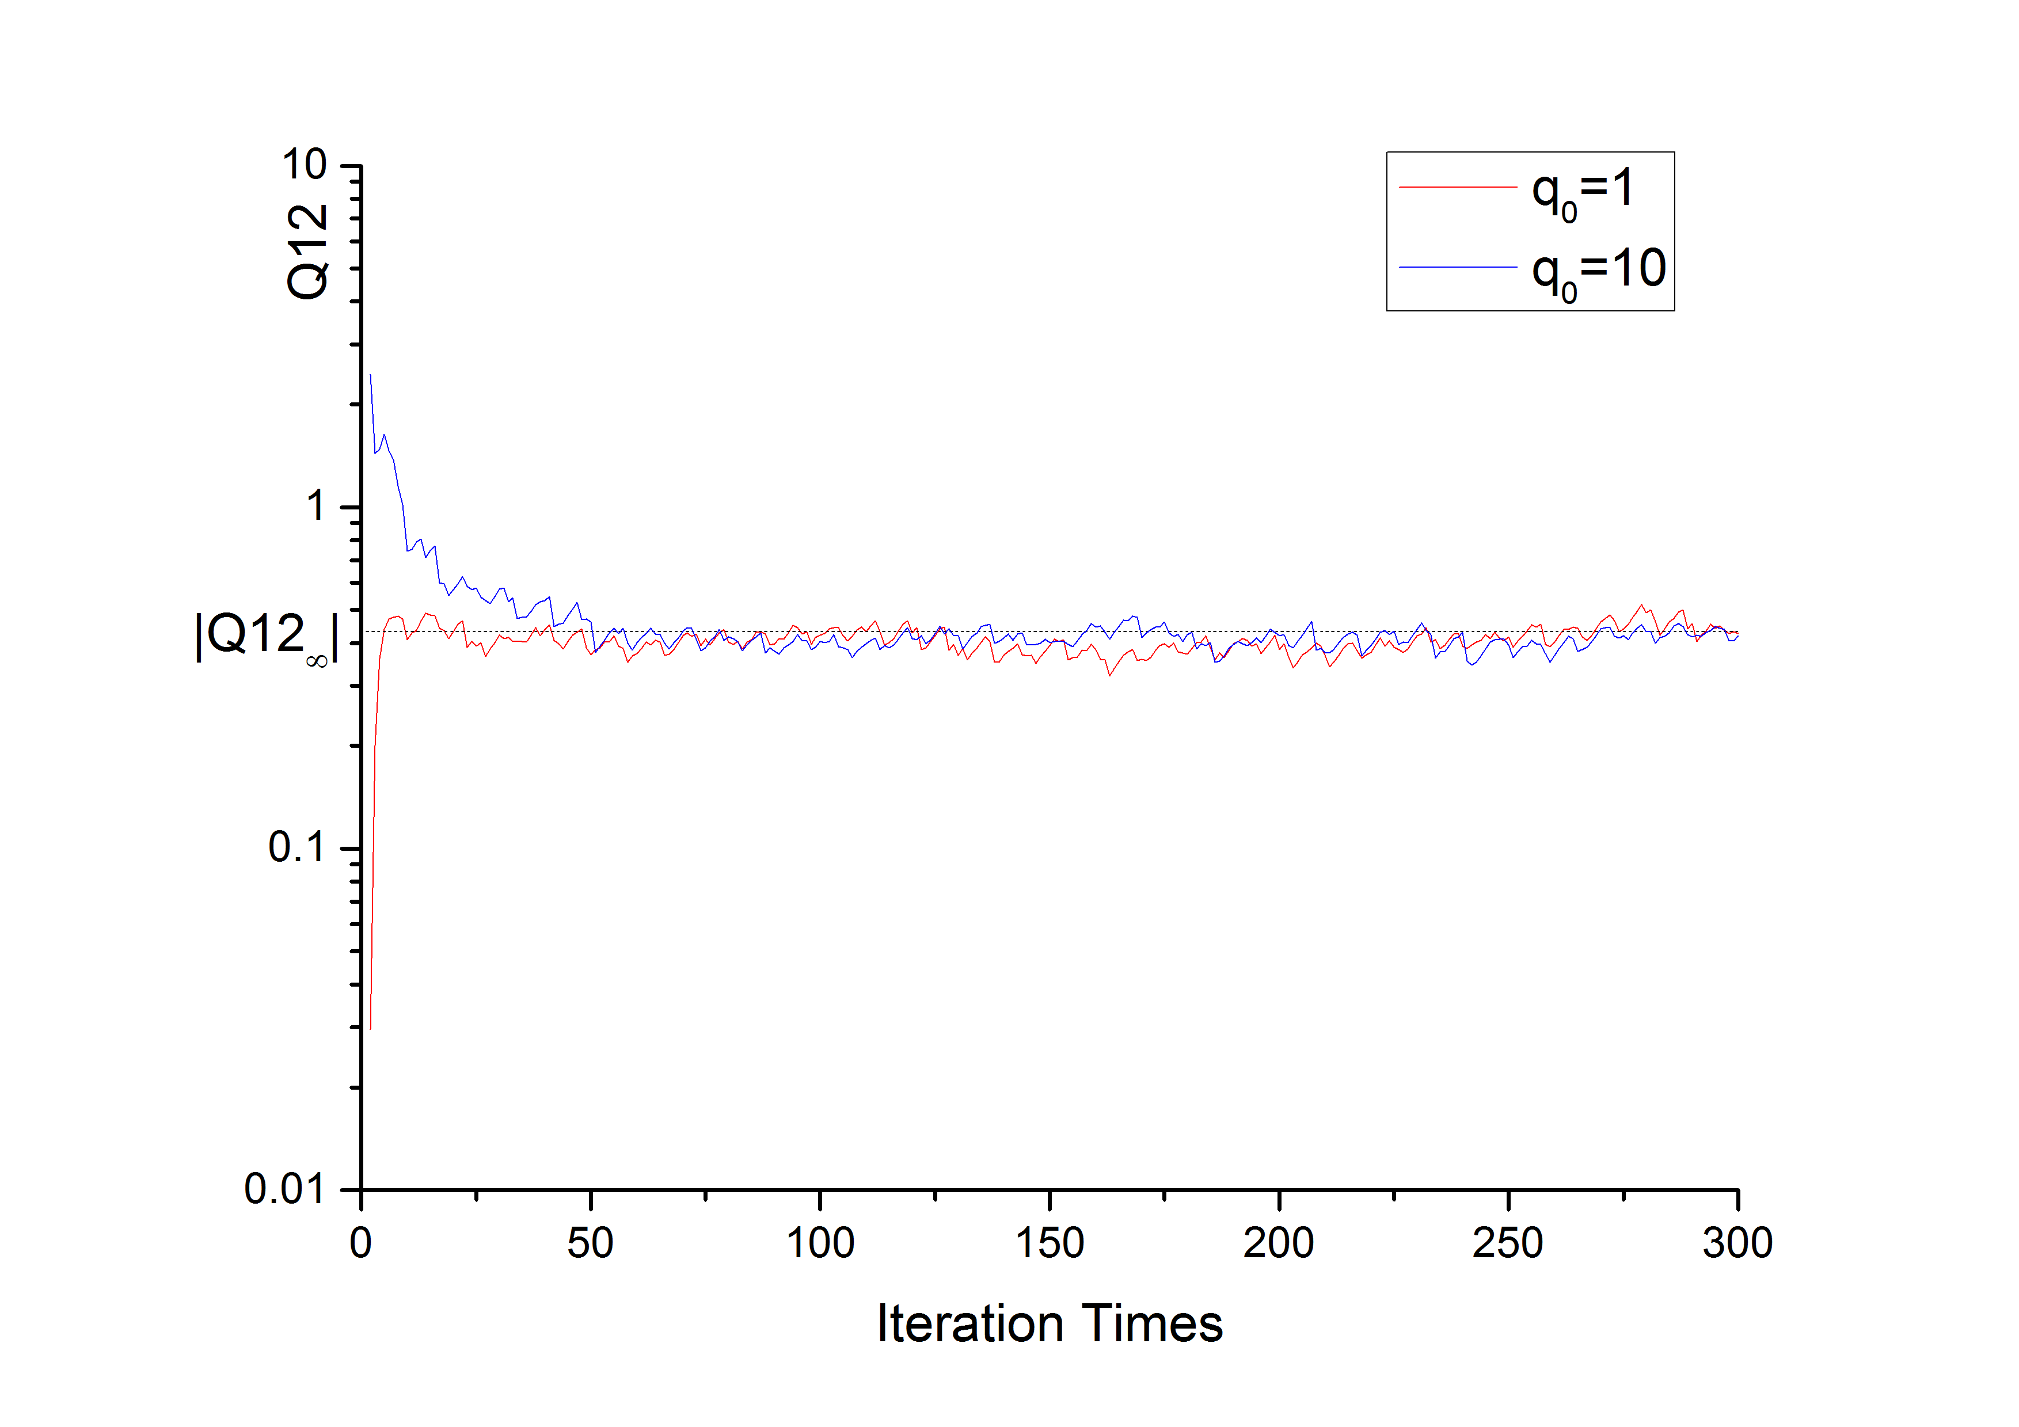
FIR| SER——Theoretical Derivation
Fig 1-3-2, Convergence of Q12,

Slide 39
FIR| SER——Simulation
Fig 1-3-3, A 2-weight Adaptive FIR,
N=16, Random Signal is a Gaussian White Noise with its power = 0.01

Slide 40
FIR| SER——Flow Chart
FIR_SER.m
Script

Slide 41
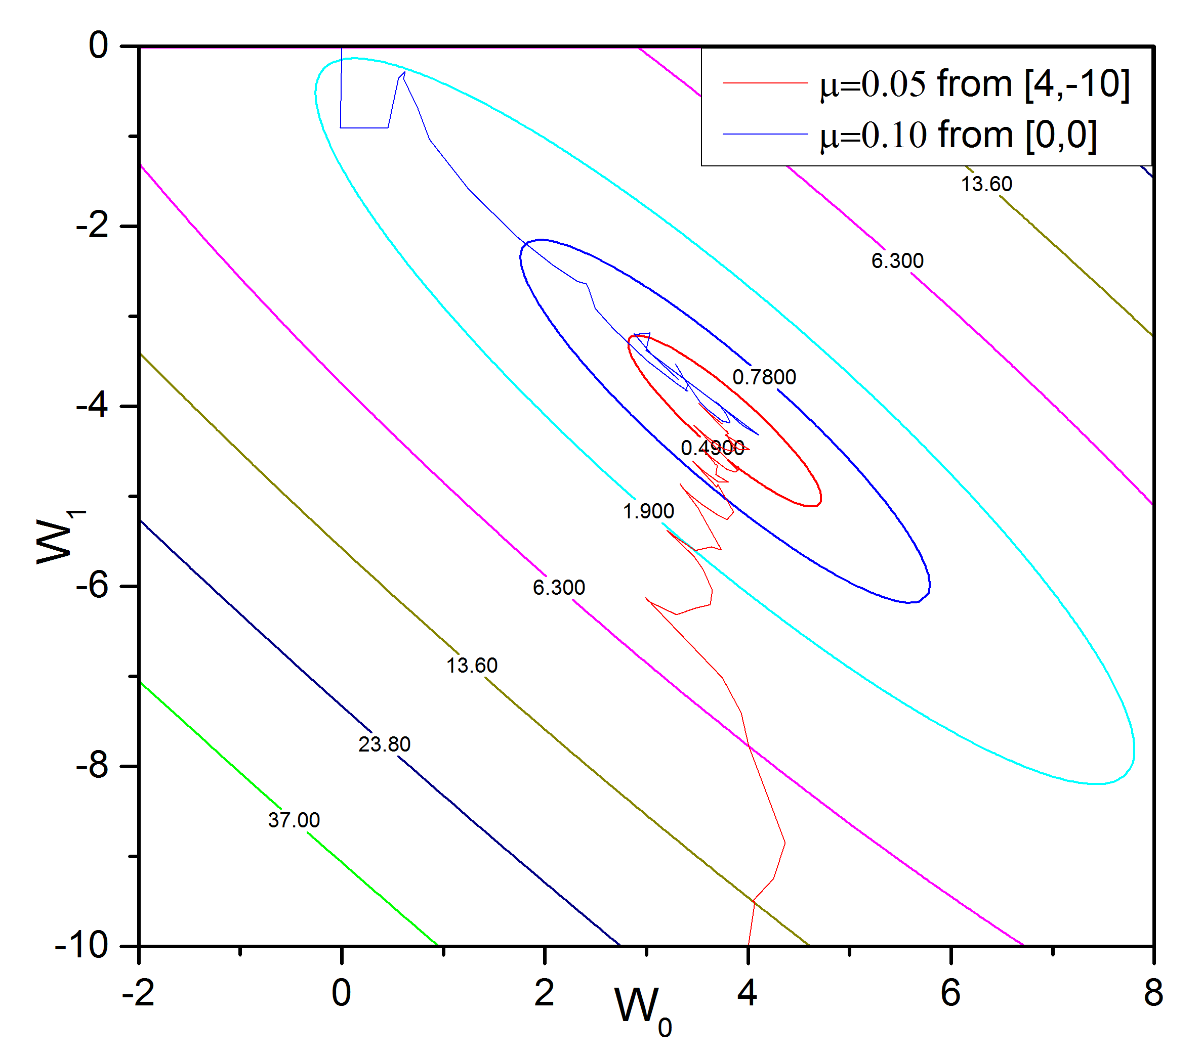
FIR| SER——Simulation Results
Fig 1-3-4, Weights Adapting Procedure using SER

Slide 42
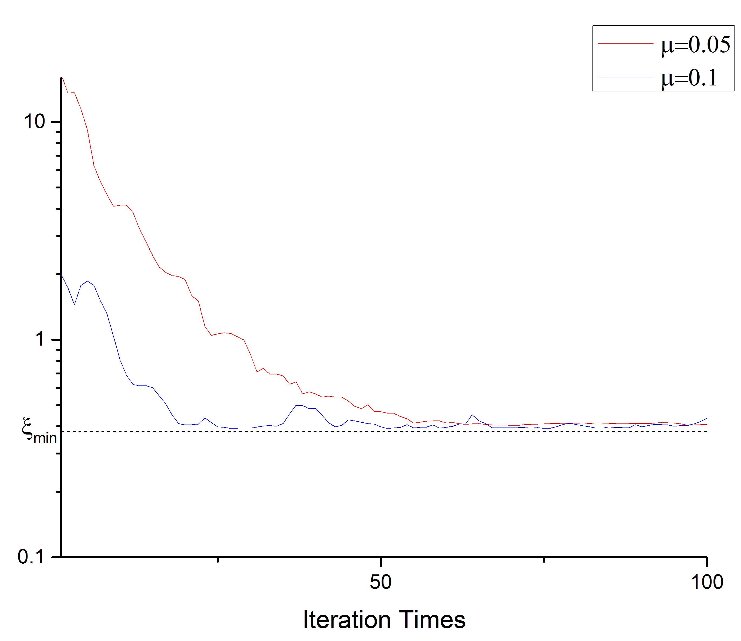
FIR| SER——Simulation Results
Fig 1-3-5, Learning Curve

Slide 43
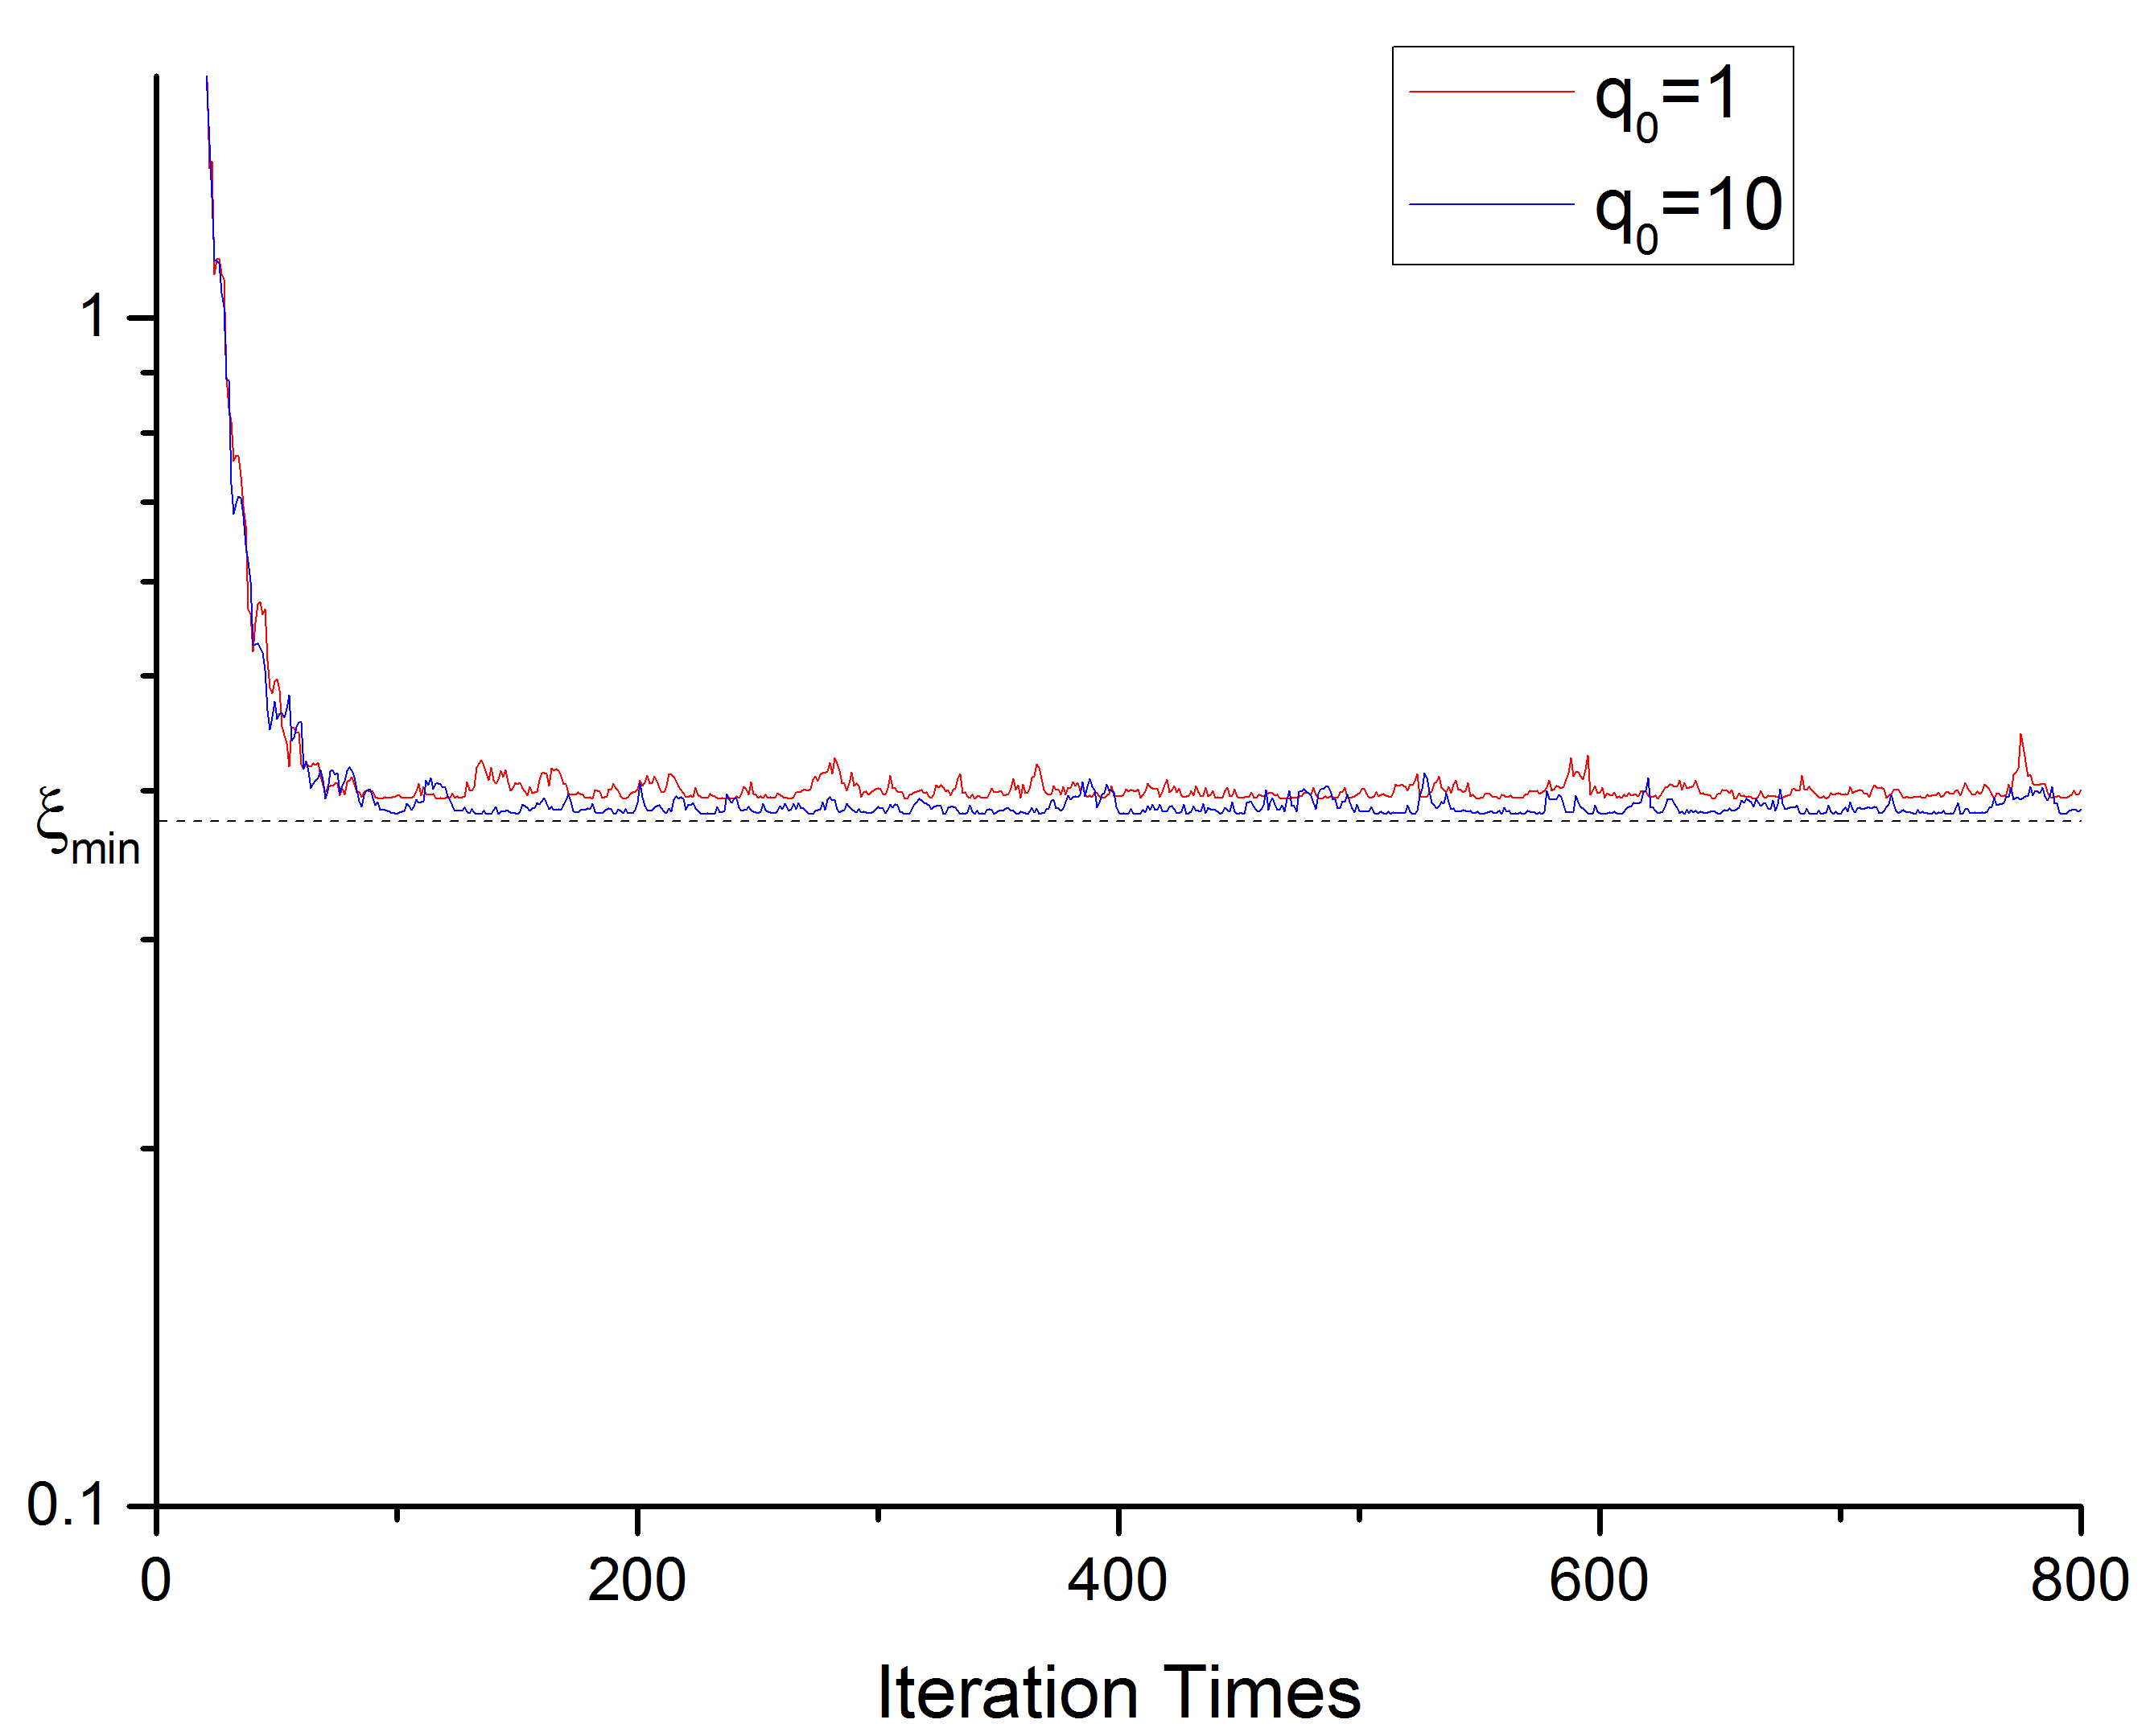
FIR| SER——Simulation Results
Fig 1-3-6, Learning Curves

Slide 44
1-4 Comparisons & Summary

Slide 45
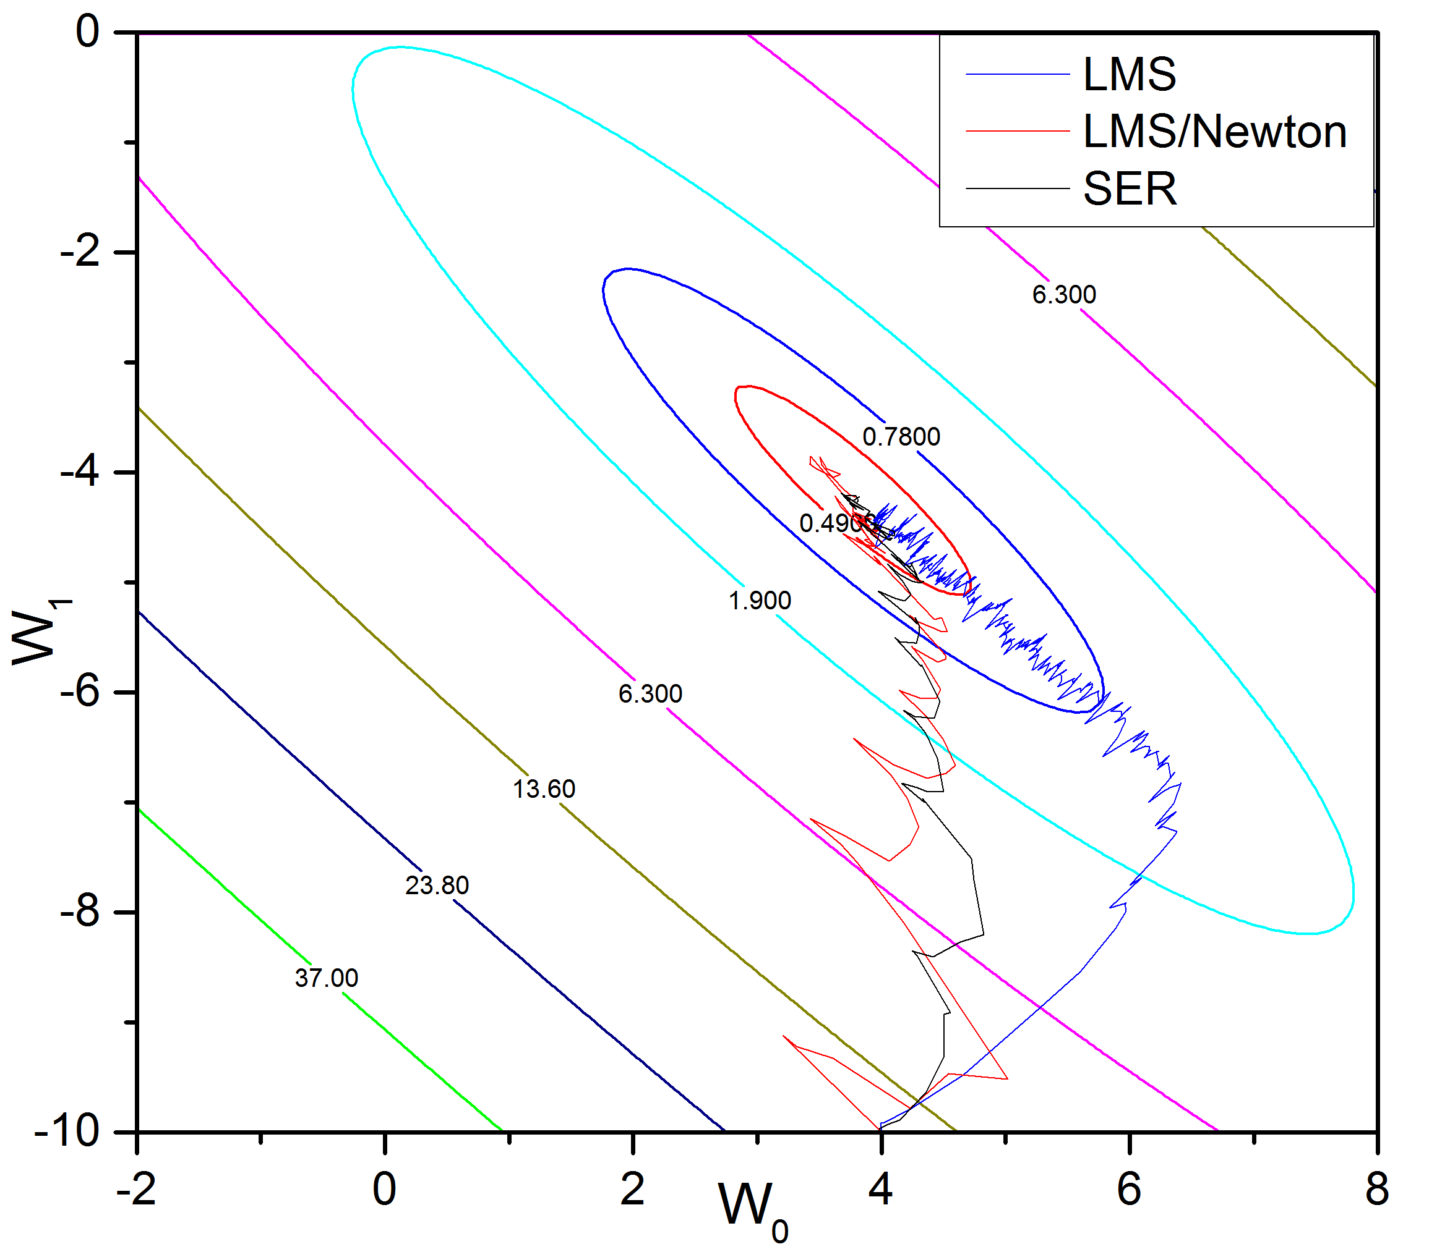
FIR| Comparisons & Summary
Fig 1-4-1, Weights Adapting Procedure using LMS, LMS/Newton and SER

Slide 46
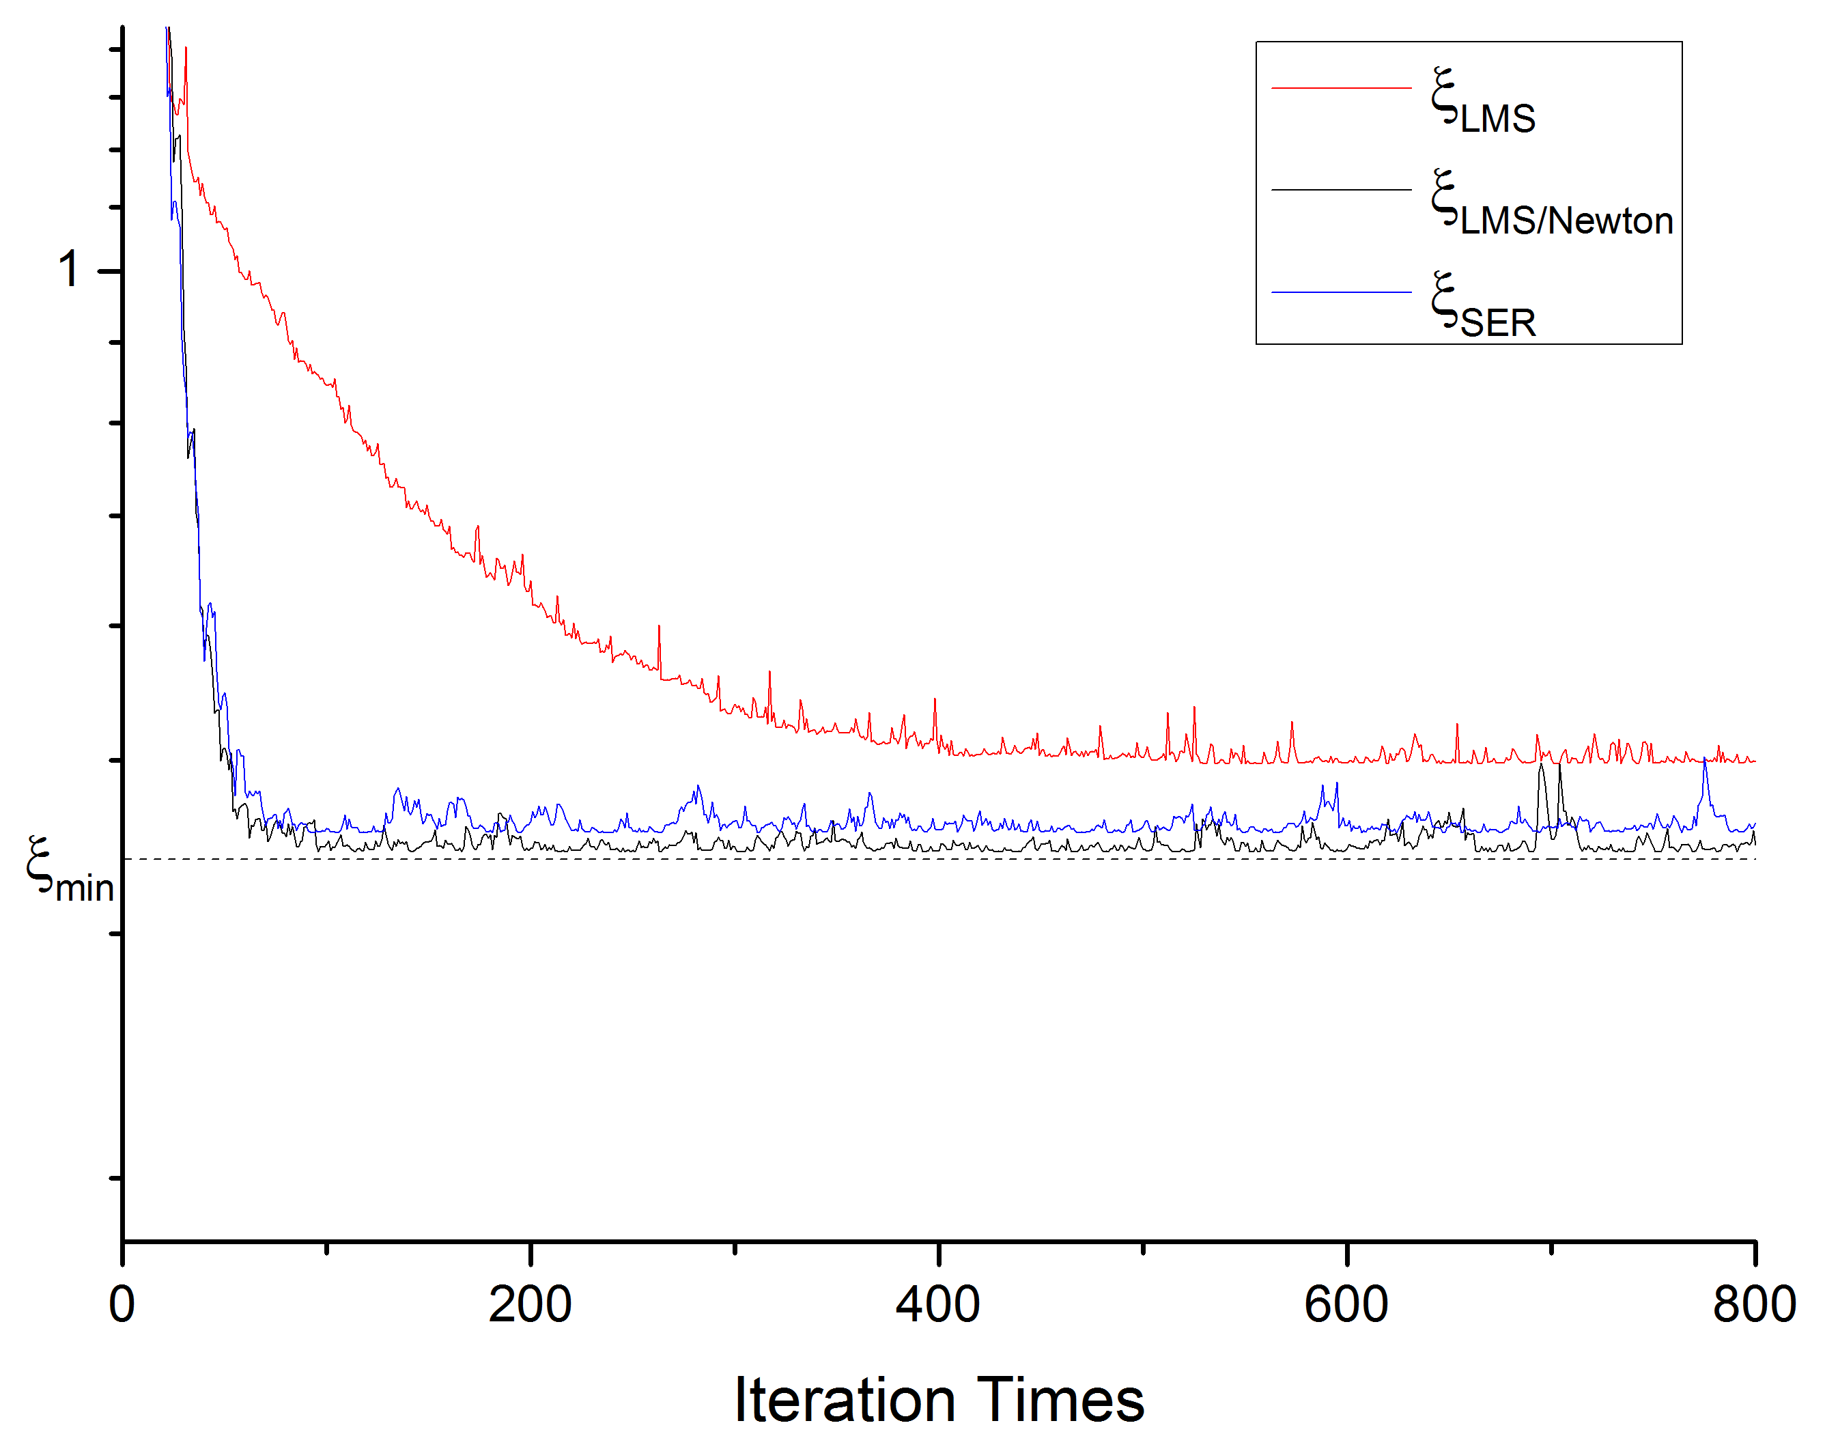
FIR| Comparisons & Summary
Fig 1-4-2, Learning Curves

Slide 47
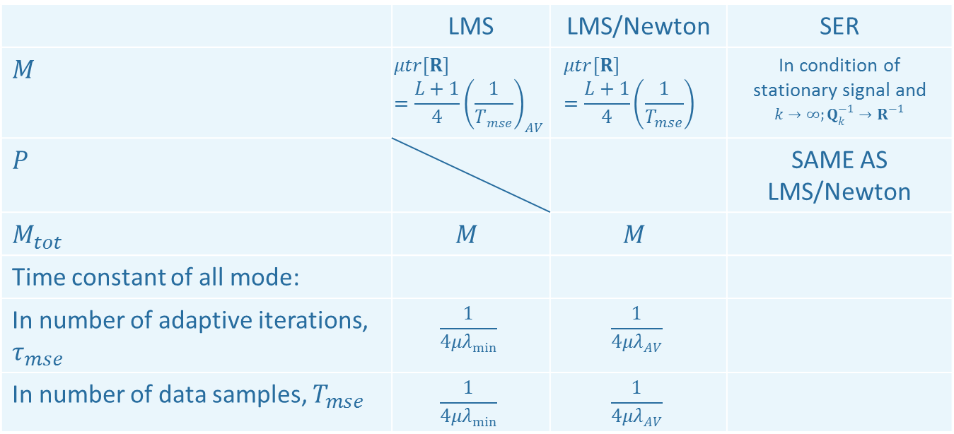
FIR| Comparisons & Summary
 | LMS | LMS/Newton | SER
$$M$$ | $$μtr[R]=\frac{L+1}{4}{\left(\frac{1}{T_{mse}}\right)}_{AV}$$ | $$μtr[R]=\frac{L+1}{4}{\left(\frac{1}{T_{mse}}\right)}_{}$$ | In condition of stationary signal and $k→∞;Q_{k}^{−1}→R^{−1}$
$$P$$ |  |  | SAME AS LMS/Newton
$$M_{tot}$$ | $$M$$ | $$M$$
Time constant of all mode:
In number of adaptive iterations, $τ_{mse}$ | $$\frac{1}{4μλ_{min}}$$ | $$\frac{1}{4μλ_{AV}}$$
In number of data samples, $T_{mse}$ | $$\frac{1}{4μλ_{min}}$$ | $$\frac{1}{4μλ_{AV}}$$

Slide 48
CHAP 2 Adaptive IIR Structure
LMS Algorithm
SER Algorithm
Comparisons & Summary

Slide 49
2-1 IIR LMS Algorithm

Slide 50
IIR| LMS——Theoretical Derivation
Define

Slide 51
IIR| LMS——Theoretical Derivation
Then

Slide 52
IIR| LMS——Theoretical Derivation
Gradient Factor
------>>

Slide 53
IIR| LMS——Theoretical Derivation
Gradient Factor
------>>

Slide 54
IIR| LMS——Theoretical Derivation
We have

Slide 55
IIR| LMS——Theoretical Derivation
IIR
LMS

Slide 56
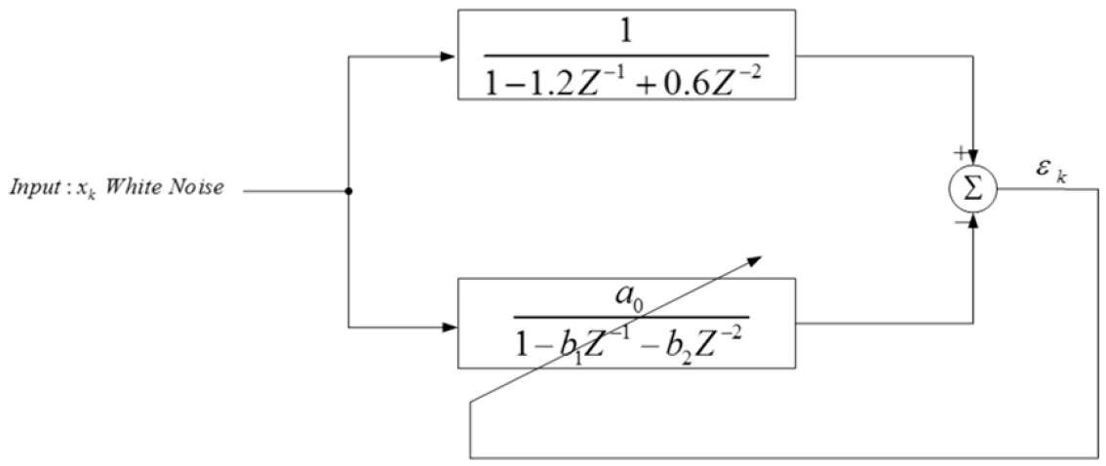
IIR| LMS——Simulation
Fig 2-1-1, an Adaptive IIR filter,
The power of input = 1

Slide 57
IIR| LMS——Theoretical Derivation

Slide 58
IIR| LMS——Theoretical Derivation

Slide 59
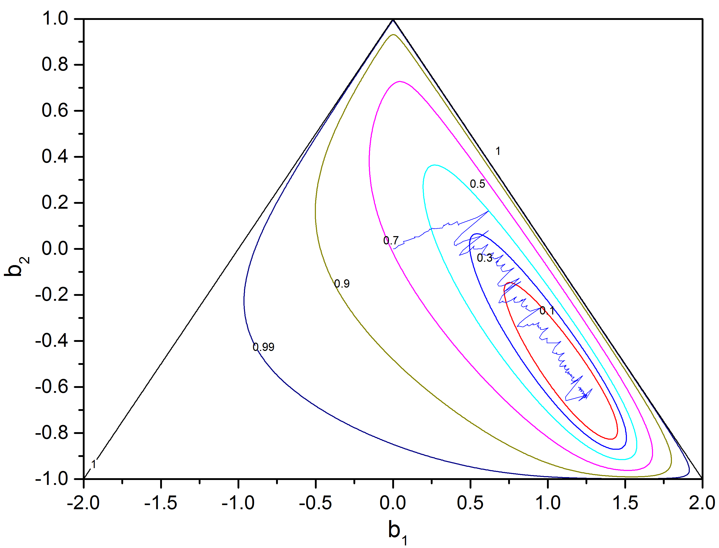
IIR| LMS——Simulation Results
IIR_LMS.m
Script
Fig 2-1-2, Weights Adapting Procedure using LMS

Slide 60
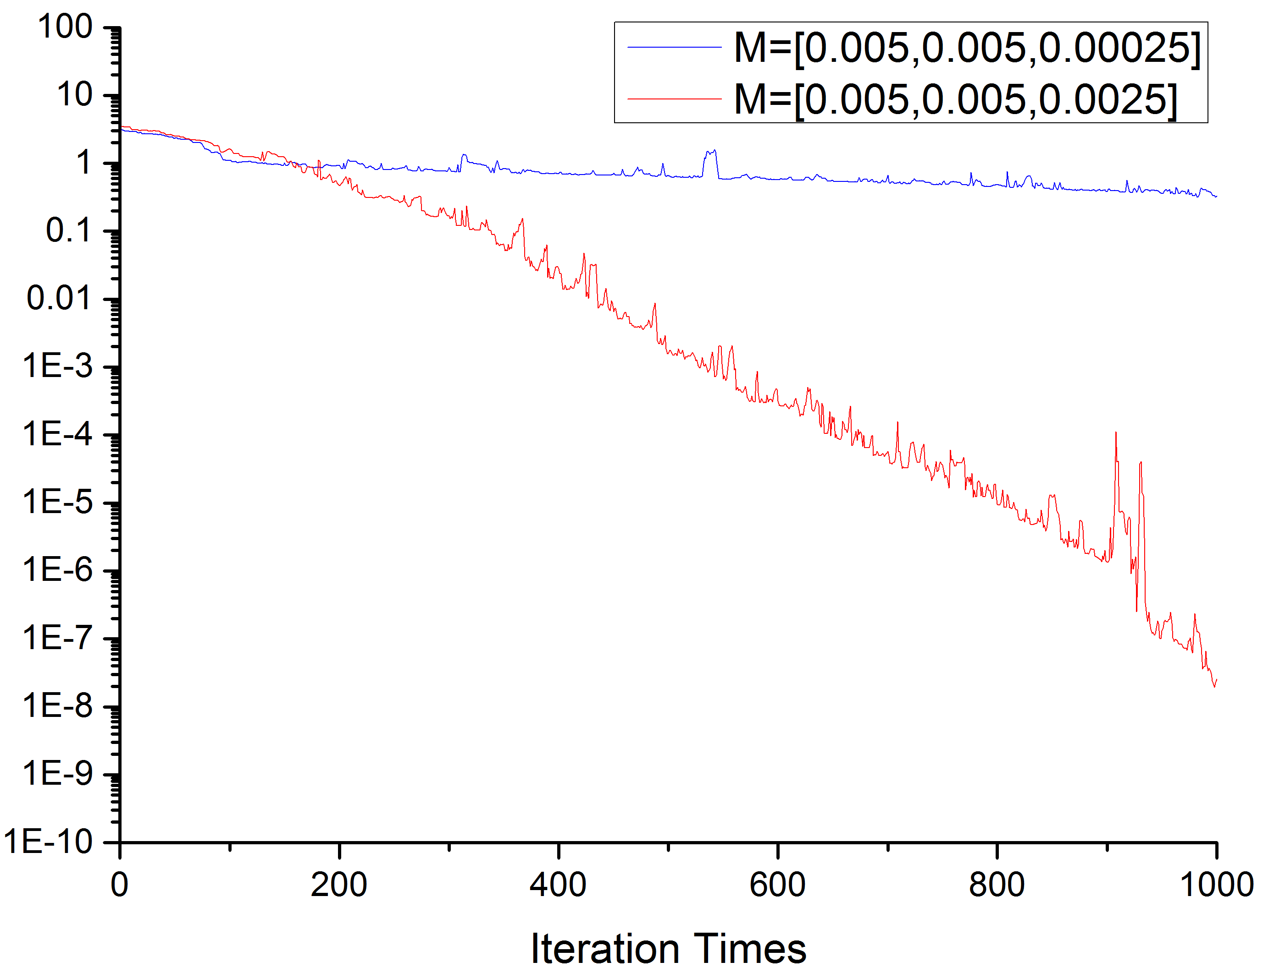
IIR| LMS——Simulation Results
Fig 2-1-3, Learning Curves

Slide 61
2-2 IIR SER Algorithm

Slide 62
IIR| SER——Theoretical Derivation

Slide 63
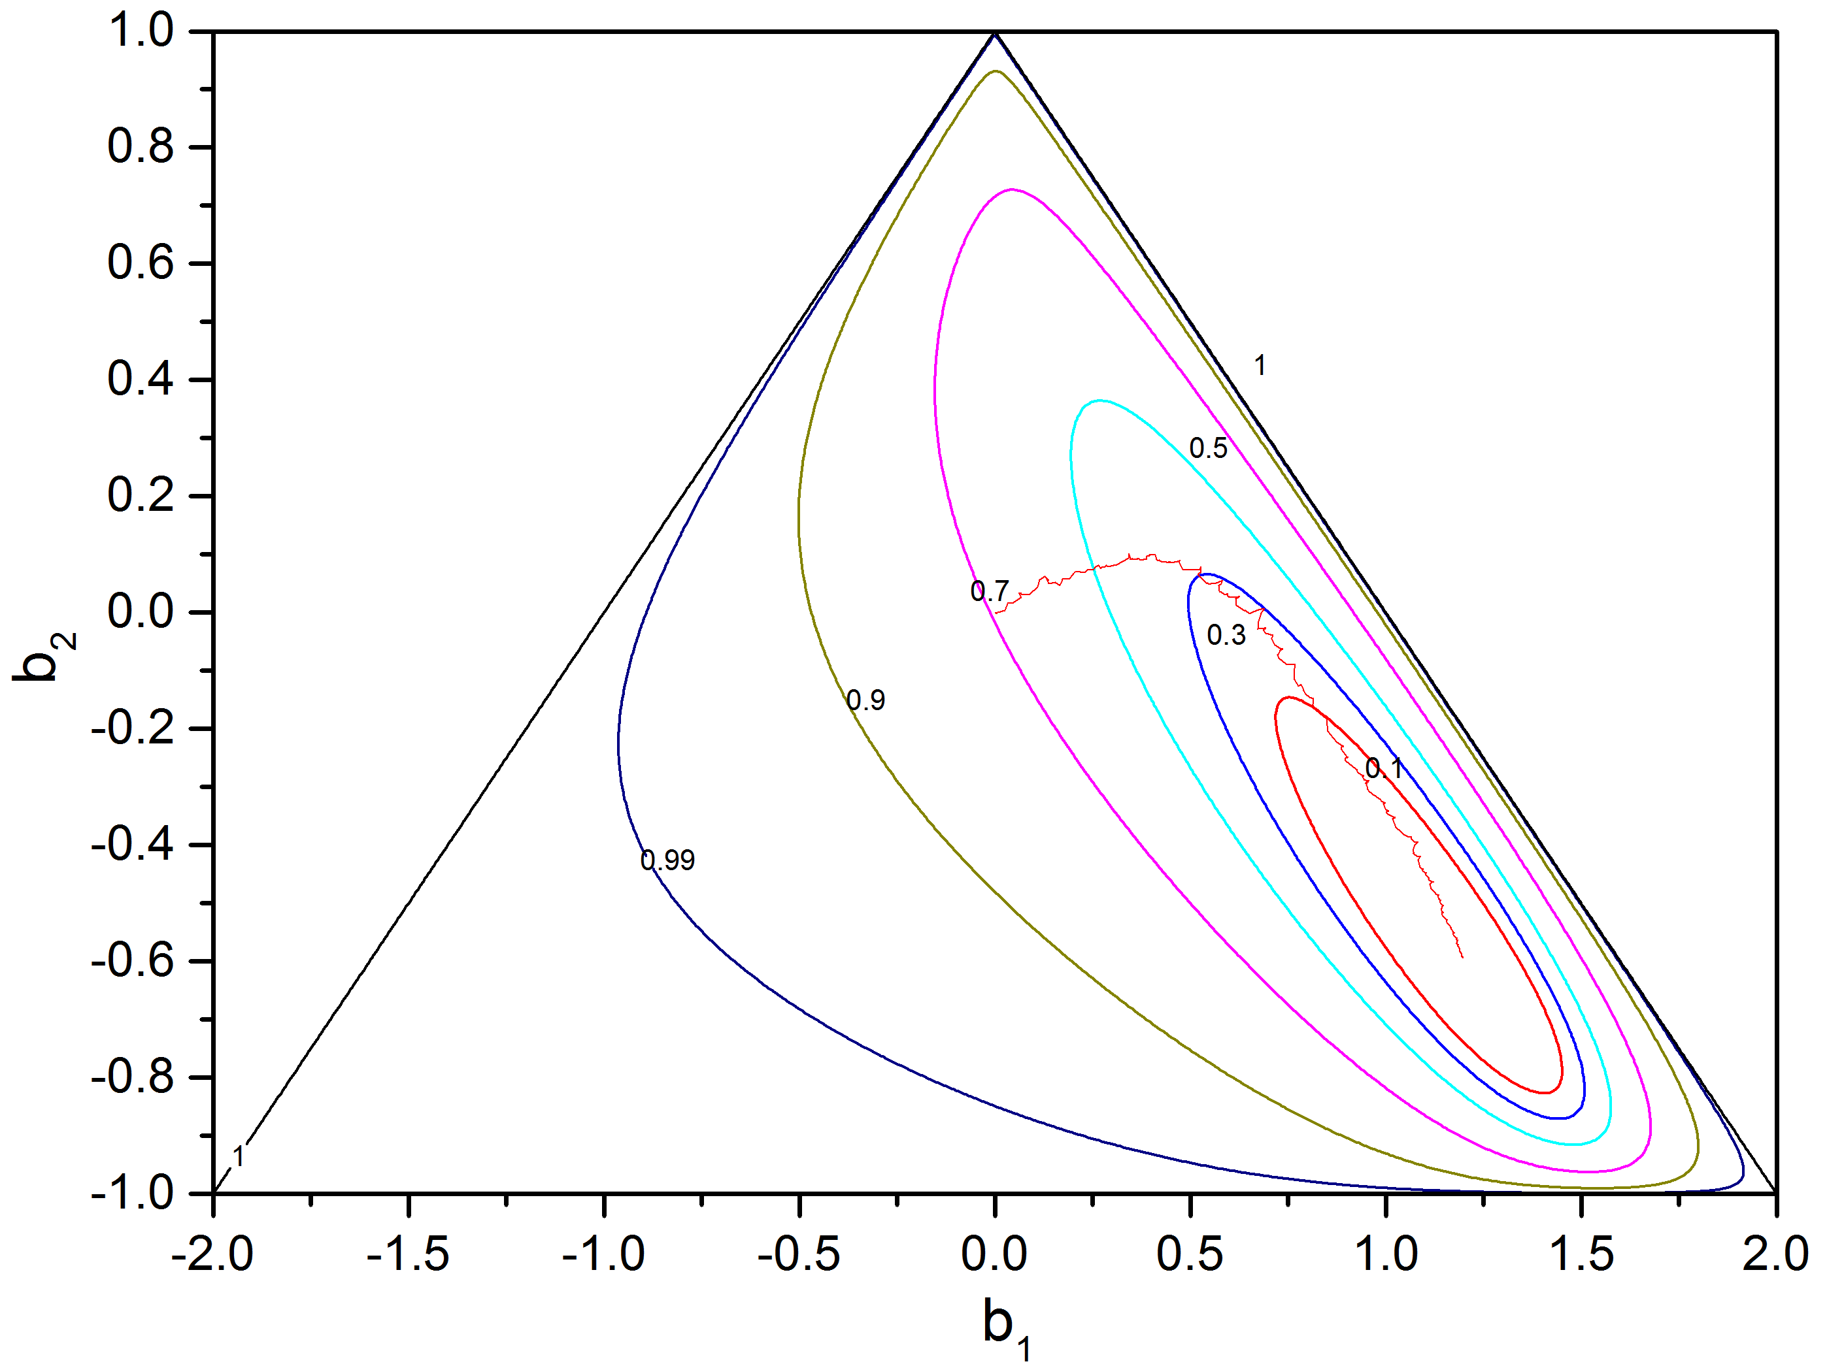
IIR| SER——Simulation Results
IIR_SER.m
Script
Fig 2-2-1, Weights Adapting Procedure using SER

Slide 64
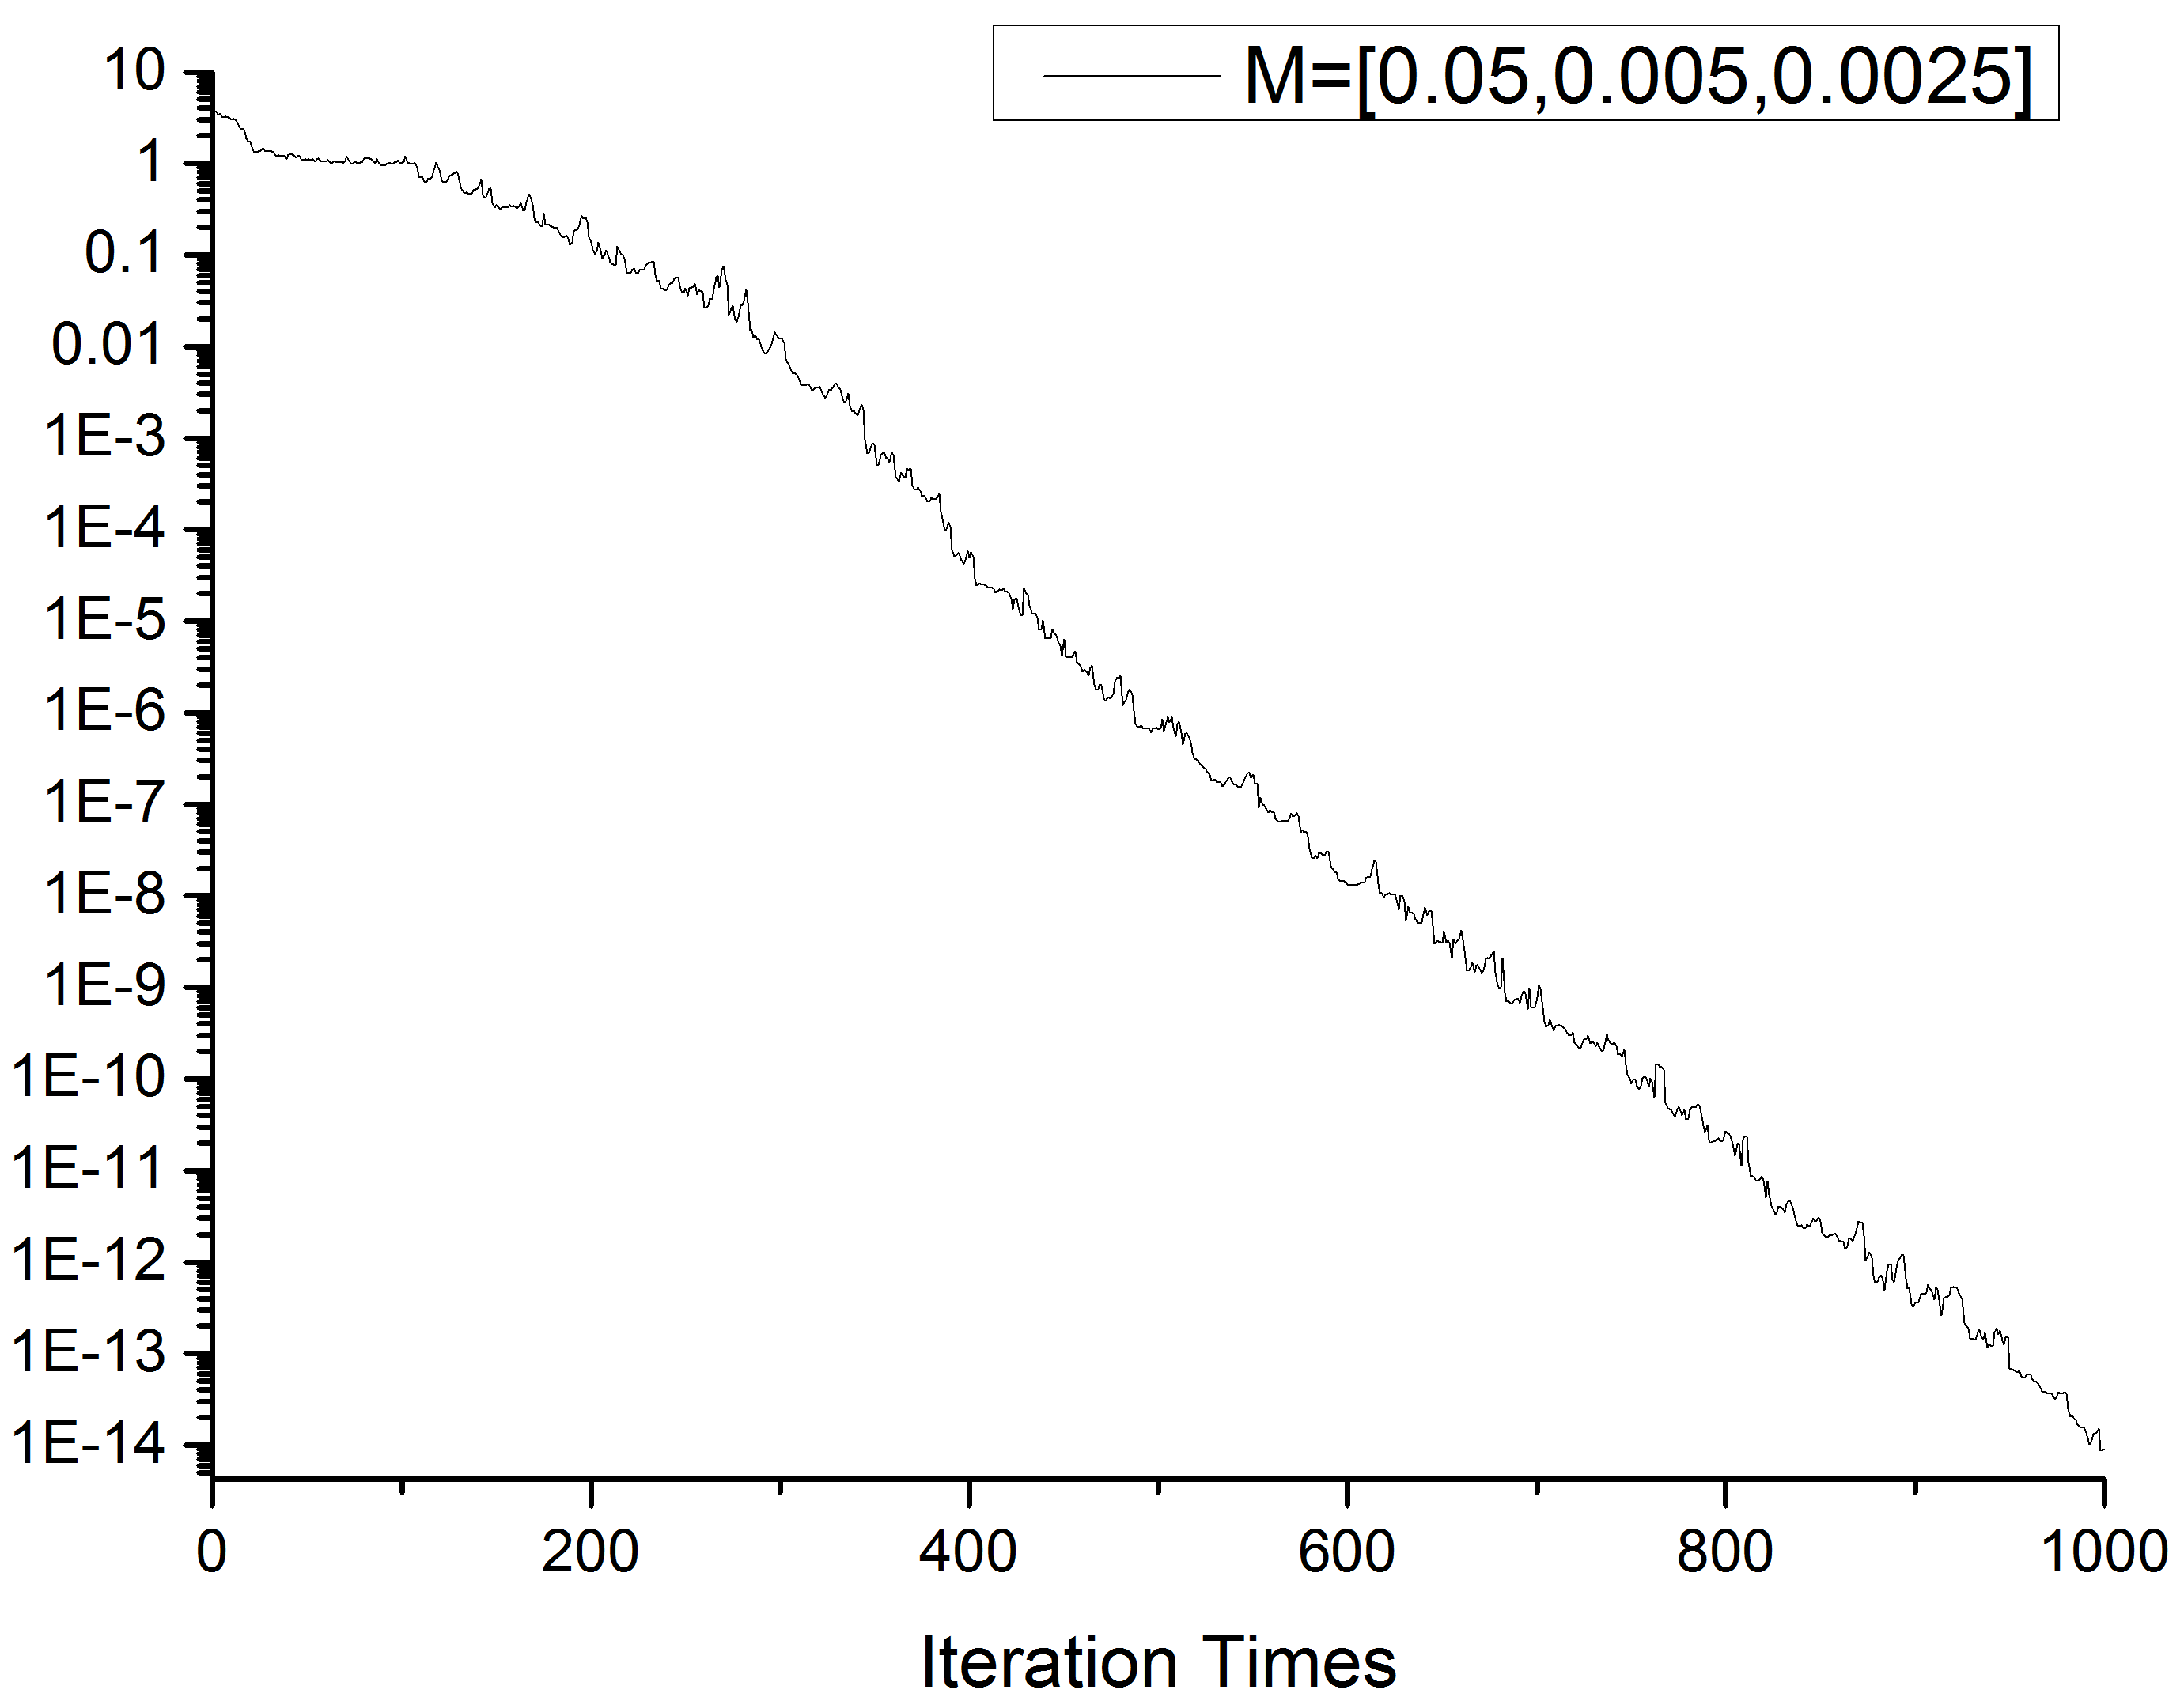
IIR| SER——Simulation Results
Fig 2-2-2, Learning Curve

Slide 65
2-3 Comparisons & Summary

Slide 66
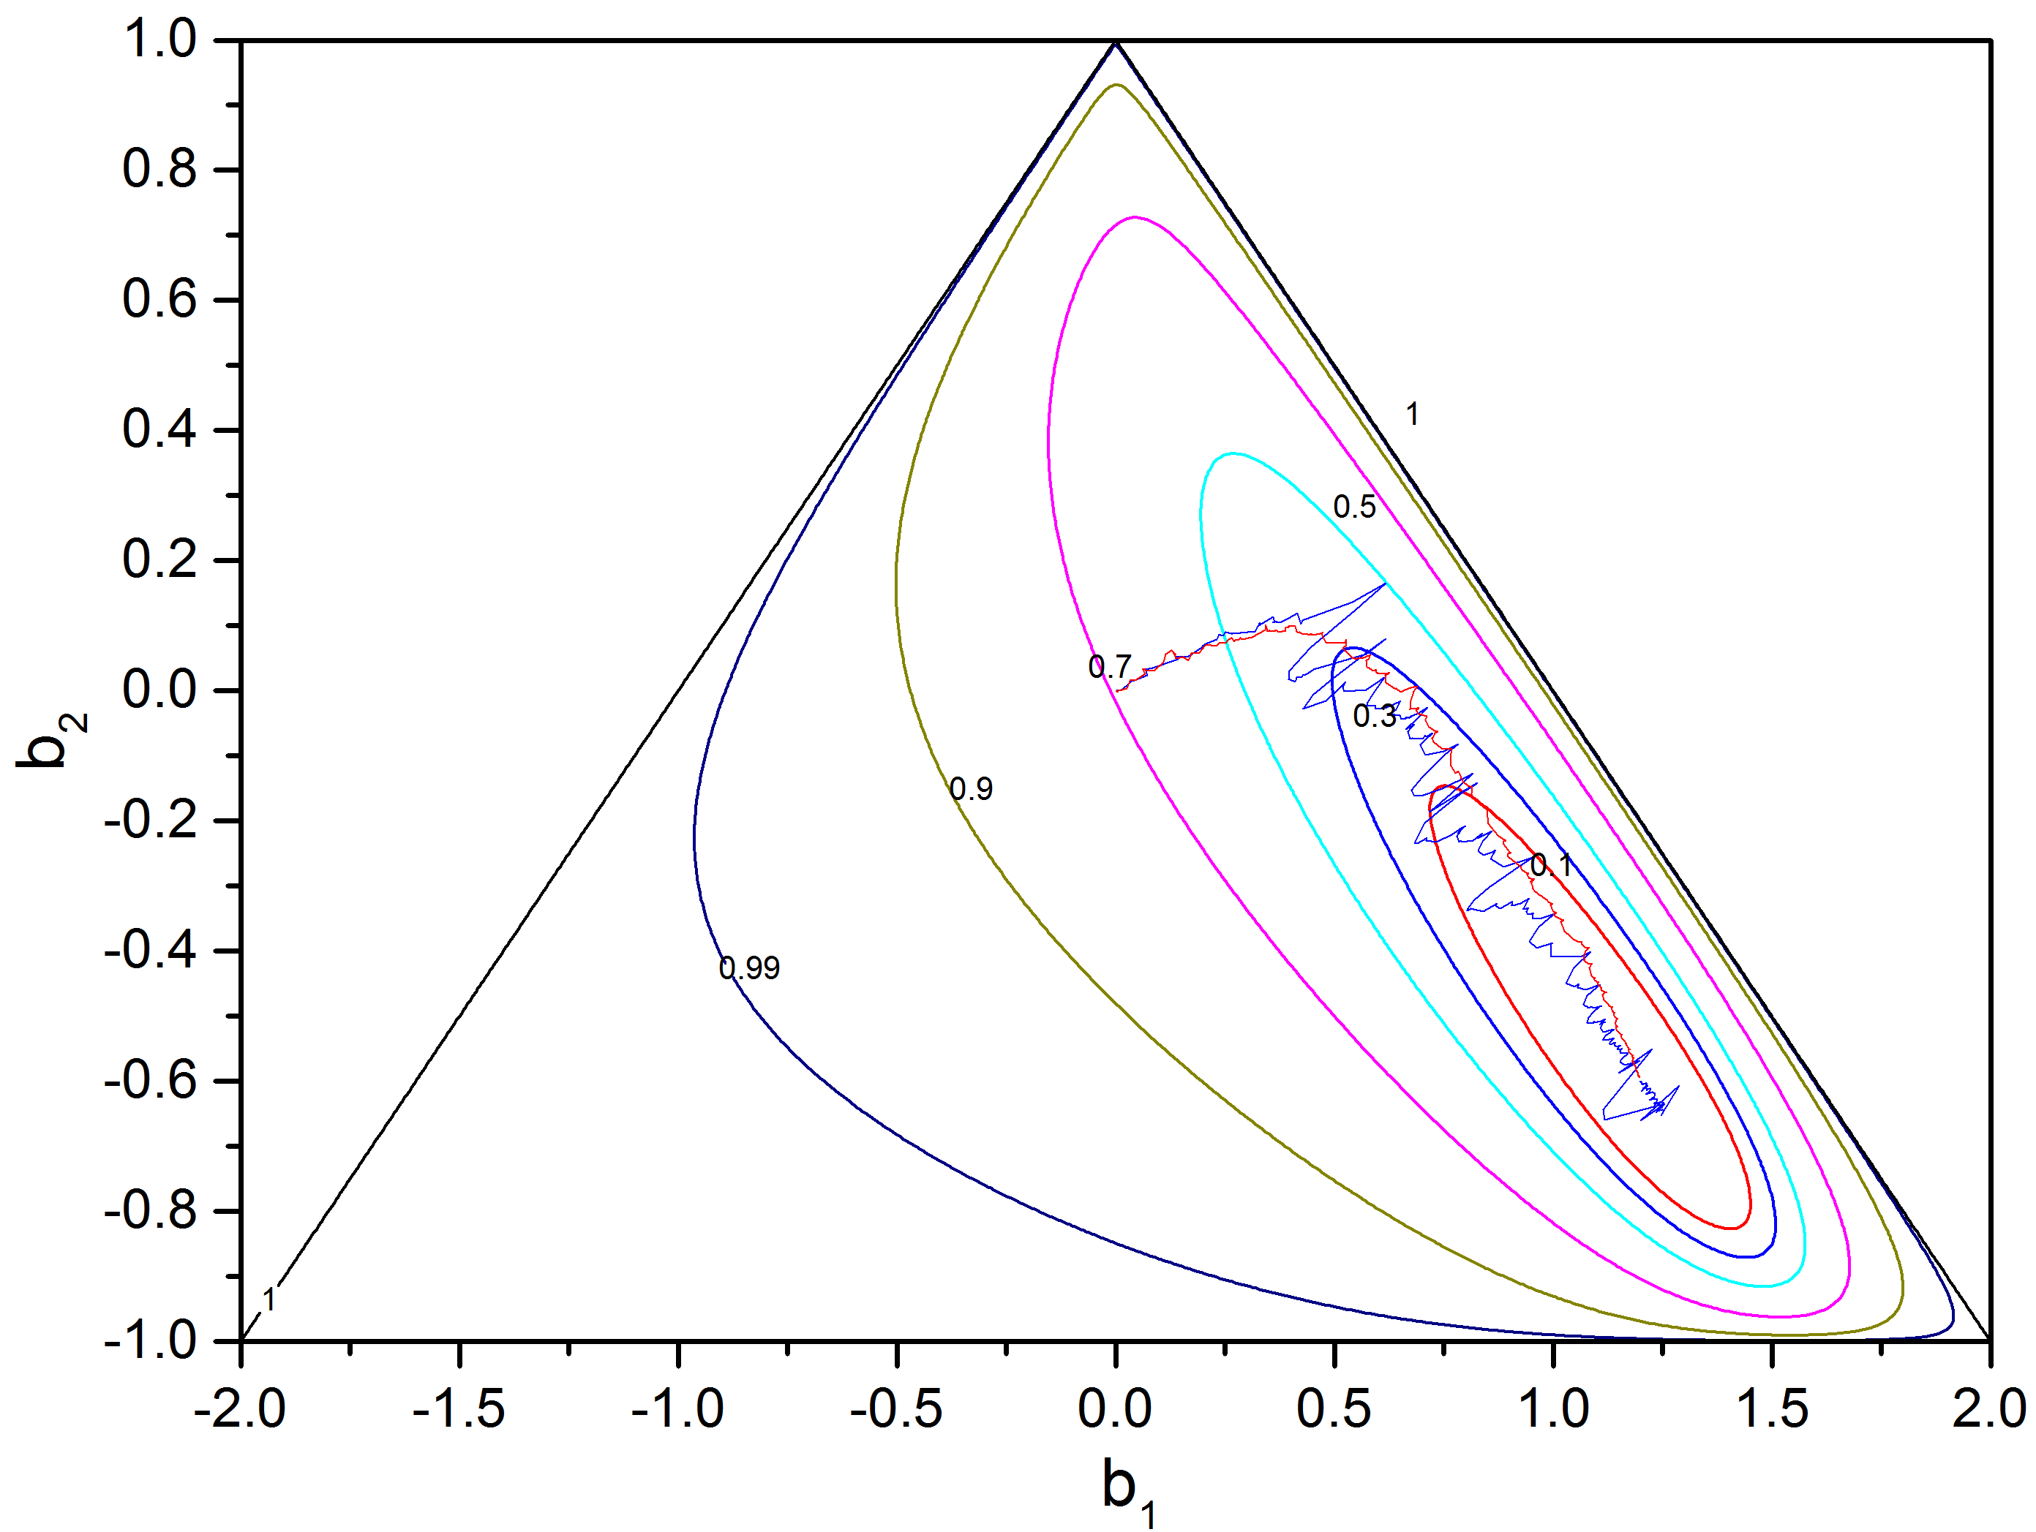
IIR| SER——Simulation Results
Fig 2-3-1, Weights Adapting Procedure using LMS and SER

Slide 67
IIR| SER——Simulation Results
Fig 2-3-2, Learning Curves

Slide 68
CHAP 3 Adaptive Lattice Structure
LMS Algorithm
SER Algorithm
Comparisons & Summary

Slide 69
3-1 Lattice LMS Algorithm

Slide 70
Lattice| LMS——Theoretical Derivation
Fig 3-1-1, basic structure of lattice one-step predictor

Slide 71
Lattice| LMS——Theoretical Derivation
In lattice structure :

Slide 72
Lattice| LMS——Theoretical Derivation
For stationary signal:
Notes:
Phi’’

Slide 73
Lattice| LMS——Theoretical Derivation
We can arrive at:

Slide 74
Lattice| LMS——Theoretical Derivation
also can arrive at:
When:

Slide 75
Lattice| LMS——Theoretical Derivation
When L=2:
At the first stage, l=0:

Slide 76
Lattice| LMS——Theoretical Derivation
When L=2: =>

Slide 77
Lattice| LMS——Theoretical Derivation
We have known the global optimum based on local optimum of each stage in lattice. We can use the square error as the estimator of its gradient as before.
Unbiased Estimator

Slide 78
Lattice| LMS——Theoretical Derivation
Lattice
LMS

Slide 79
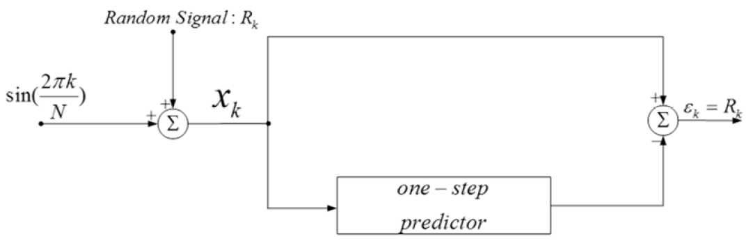
Lattice| LMS——Simulation
Fig 3-1-2, a 2-stage Adaptive one-step predictor,
N=16, Random Signal is a Gaussian White Noise with its power = 0.01

Slide 80
Lattice| LMS——Simulation
Fig 3-1-2, a 2-stage Adaptive one-step predictor,
N=16, Random Signal is a Gaussian White Noise with its power = 0.01
LatticePredictor.m
Function
Lattice_LMS.m
Script

Slide 81
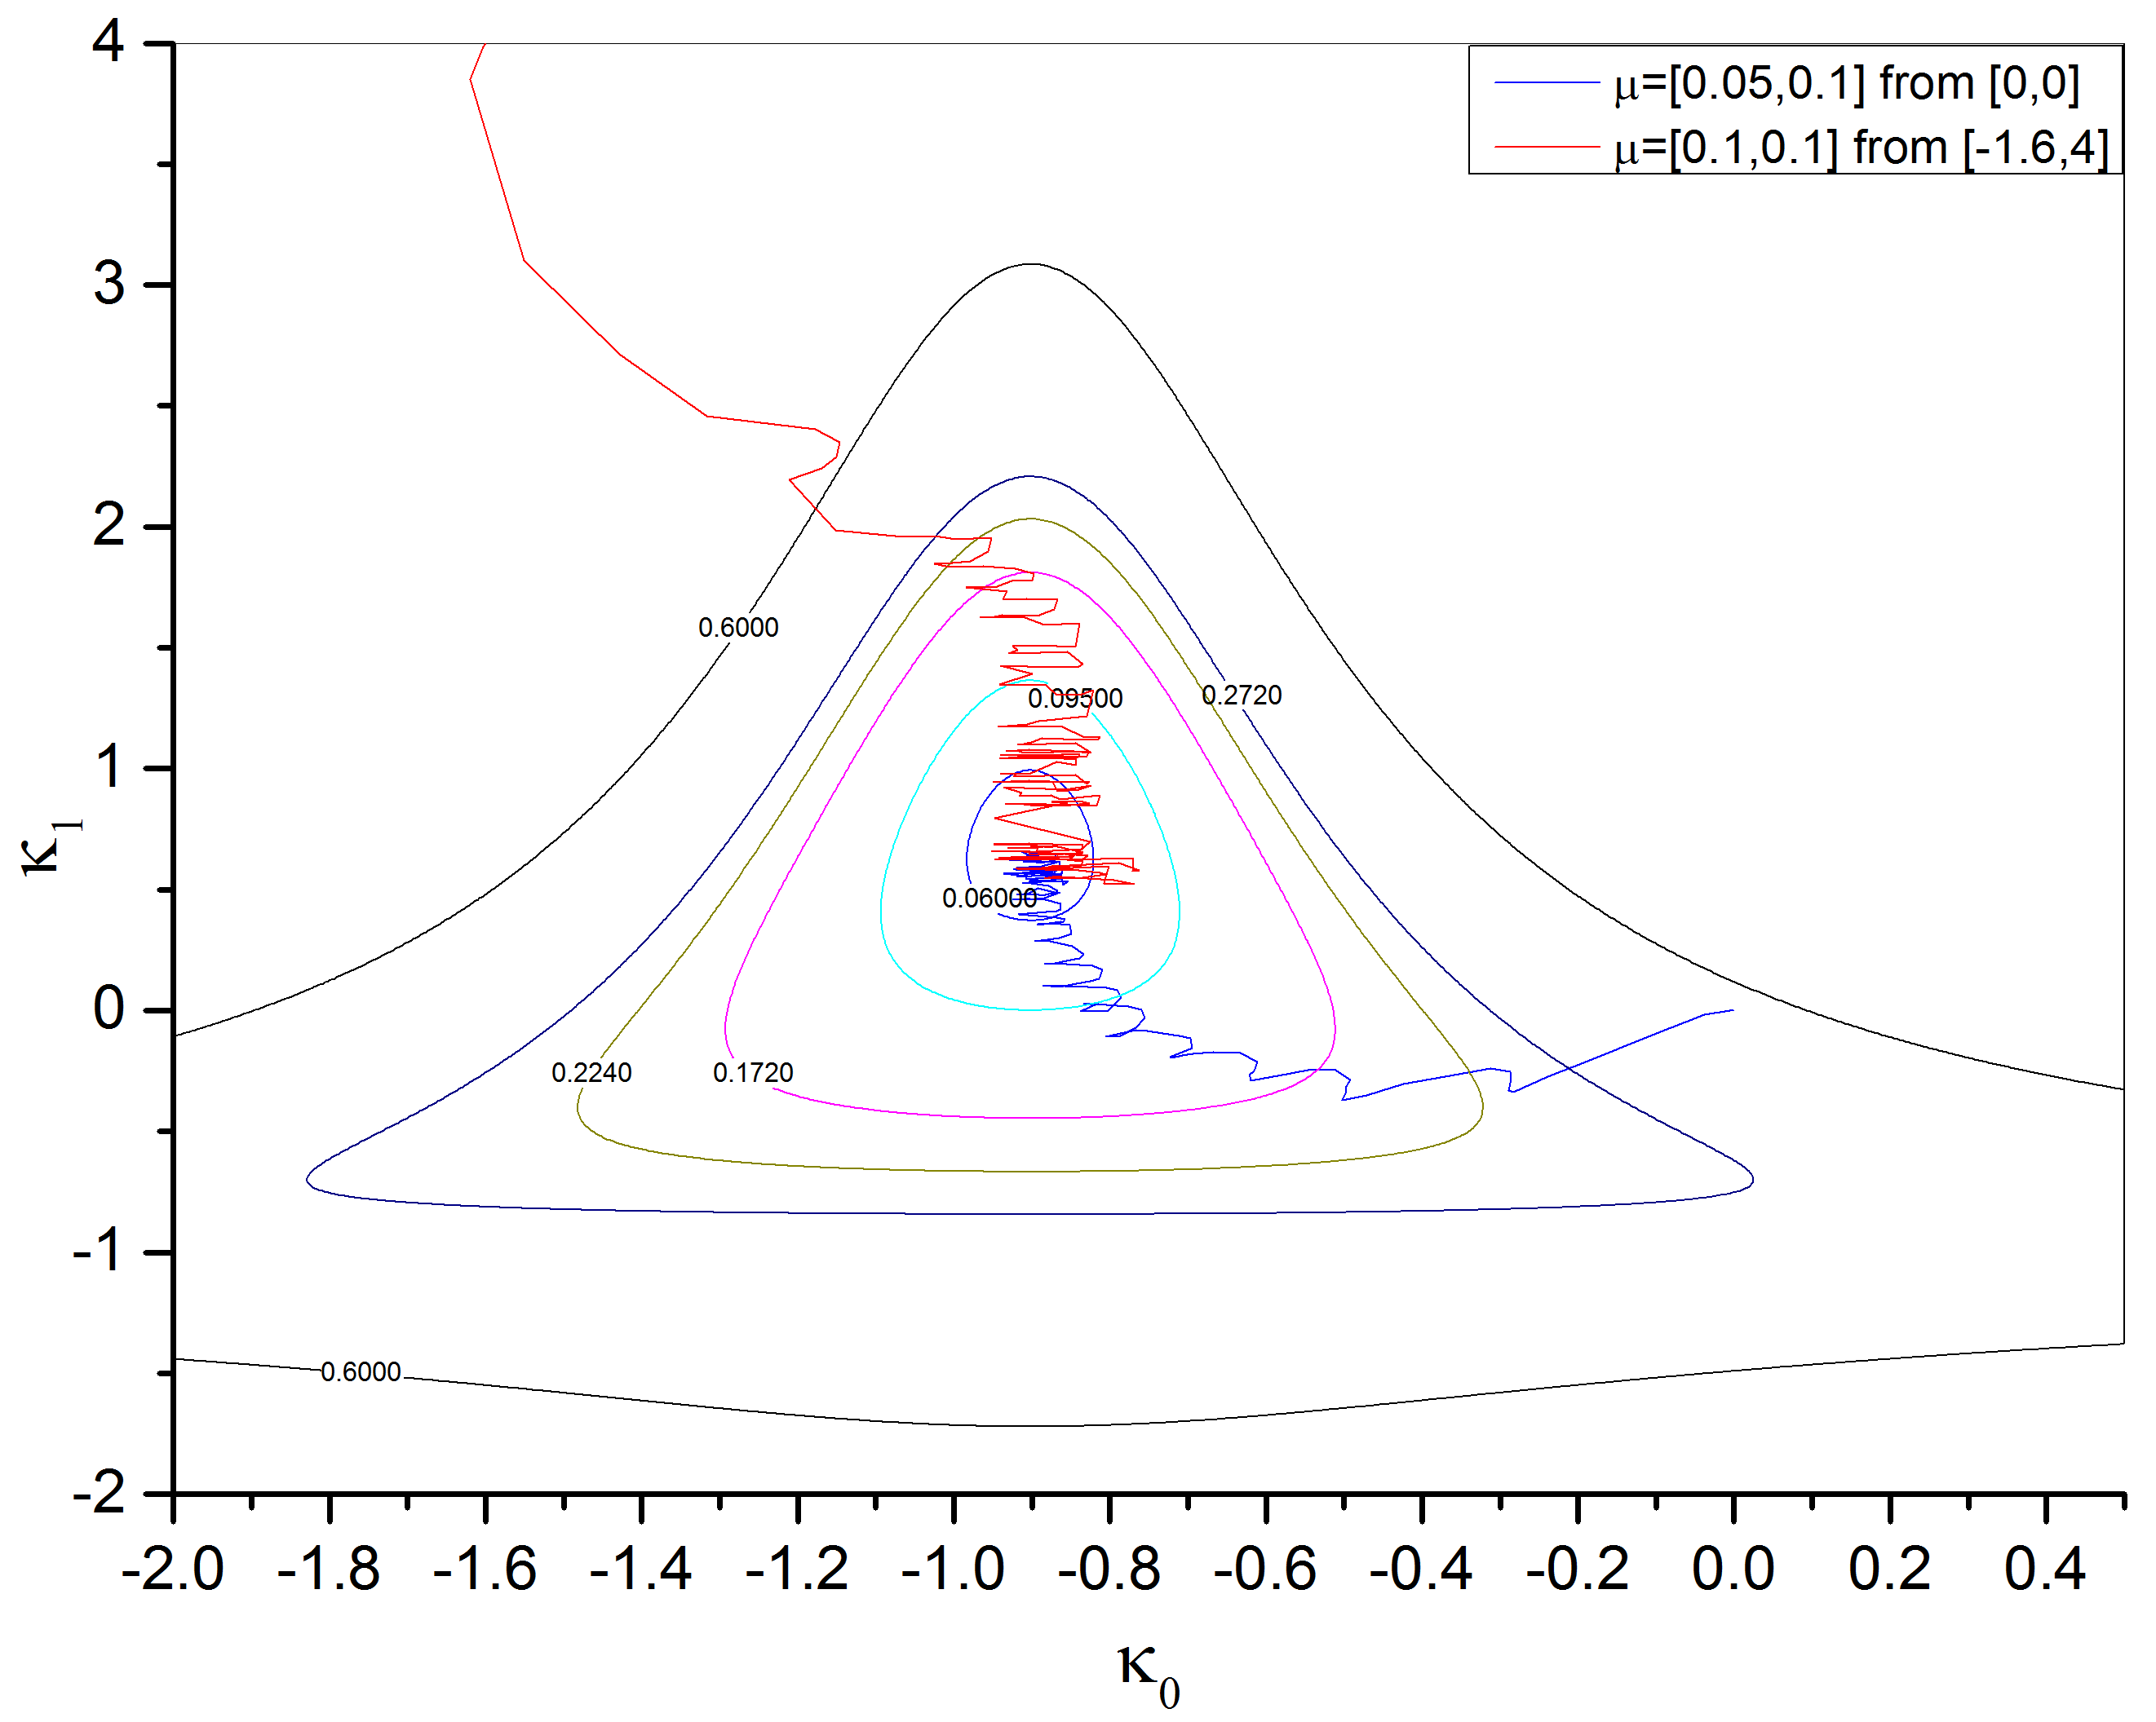
Lattice| LMS——Simulation Results
Lattice_LMS.m
Script
Fig 3-1-3, Weights Adapting Procedure using LMS

Slide 82
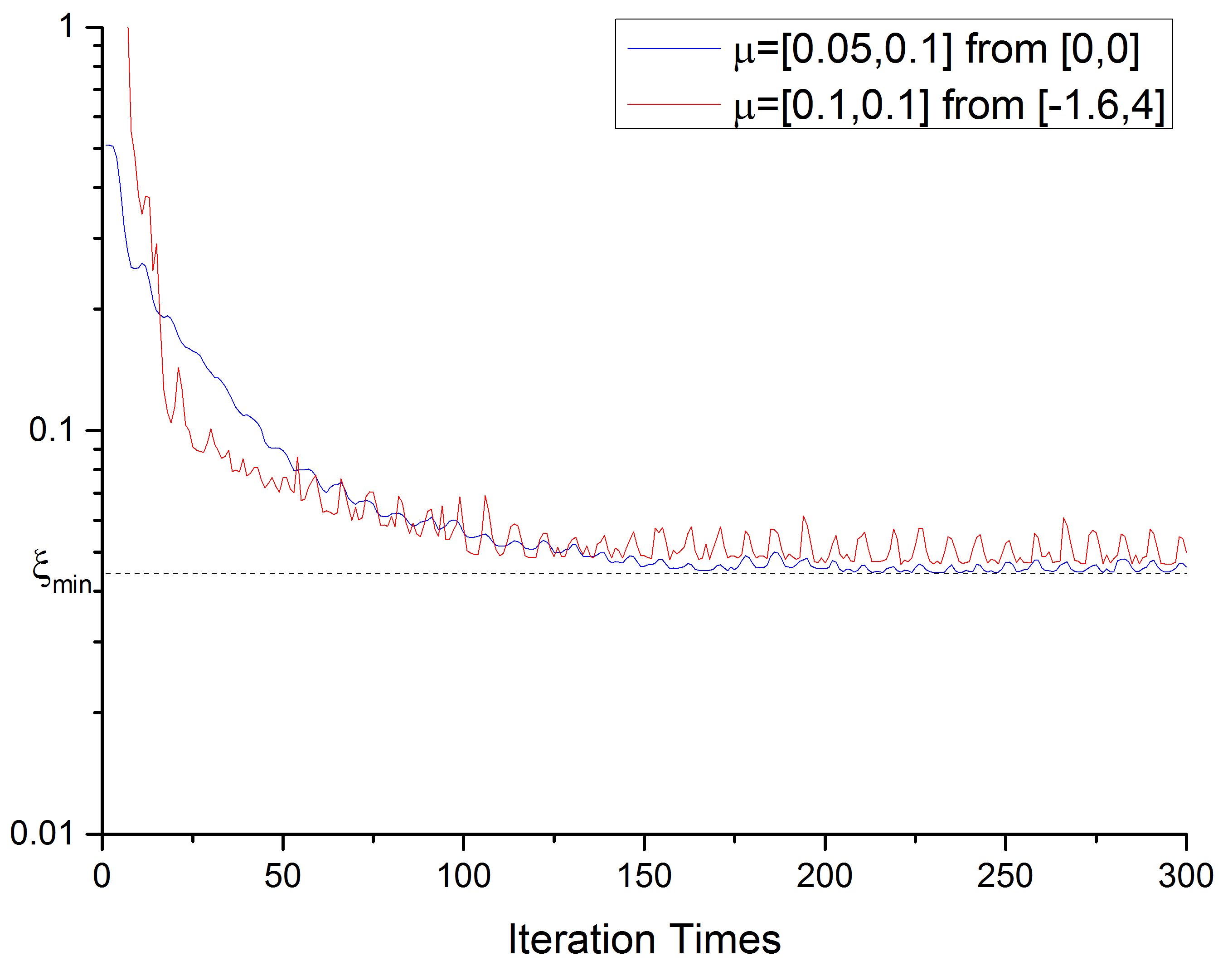
Lattice| LMS——Simulation Results
Fig 3-1-4, Learning Curves

Slide 83
3-2 Lattice SER Algorithm

Slide 84


Lattice| SER——Theoretical Derivation
Replace with$\hat{∇}$
Just like $R^{−1}$

Slide 85
Lattice| SER——Theoretical Derivation
Lattice
SER
Initiation

Slide 86
Lattice| SER——Theoretical Derivation
Following
Iterations

Slide 87
Lattice| SER——Simulation
Fig 3-2-1, a 2-stage Adaptive one-step predictor,
N=16, Random Signal is a Gaussian White Noise with its power = 0.01
Lattice_SER.m
Script

Slide 88
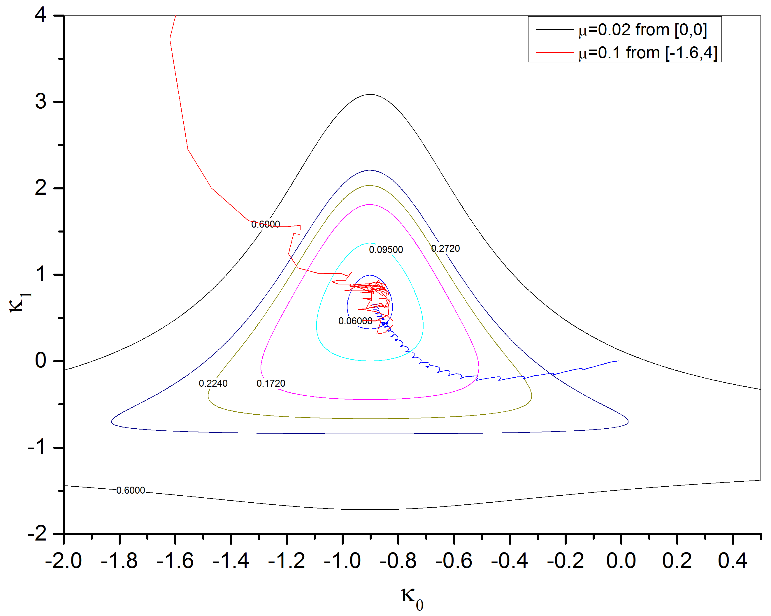
Lattice| SER——Simulation Results
Lattice_SER.m
Script
Fig 3-2-2, Weights Adapting Procedure using SER

Slide 89
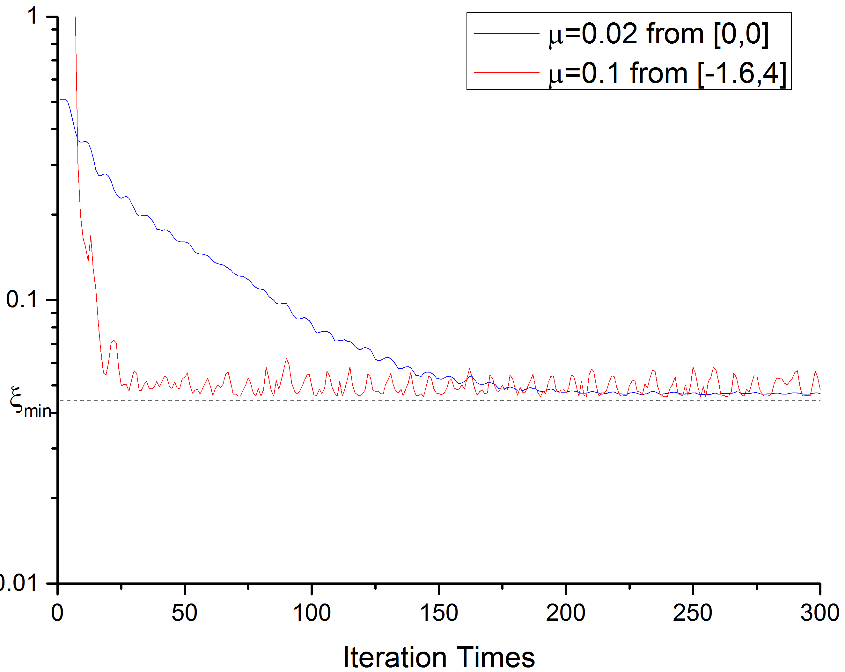
Lattice| SER——Simulation Results
Fig 3-2-3, Weights Adapting Procedure using SER

Slide 90
3-3 Comparisons & Summary

Slide 91
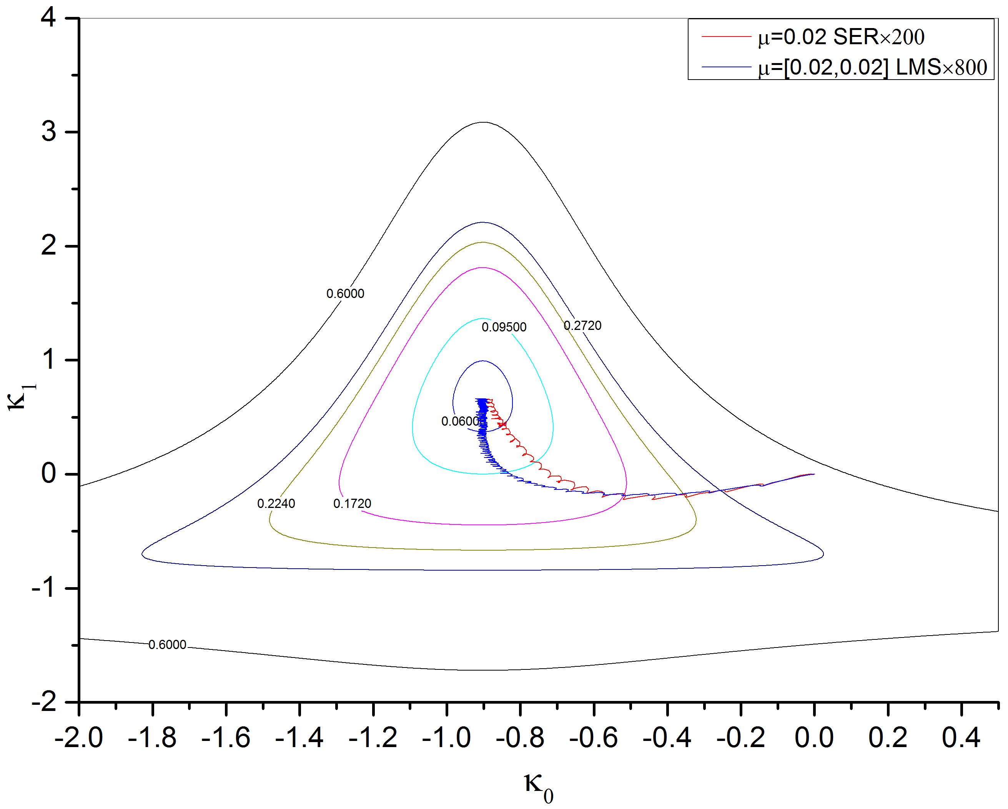
Lattice| Comparisons & Summary
Fig 3-3-1, Weights Adapting Procedure using LMS and SER

Slide 92
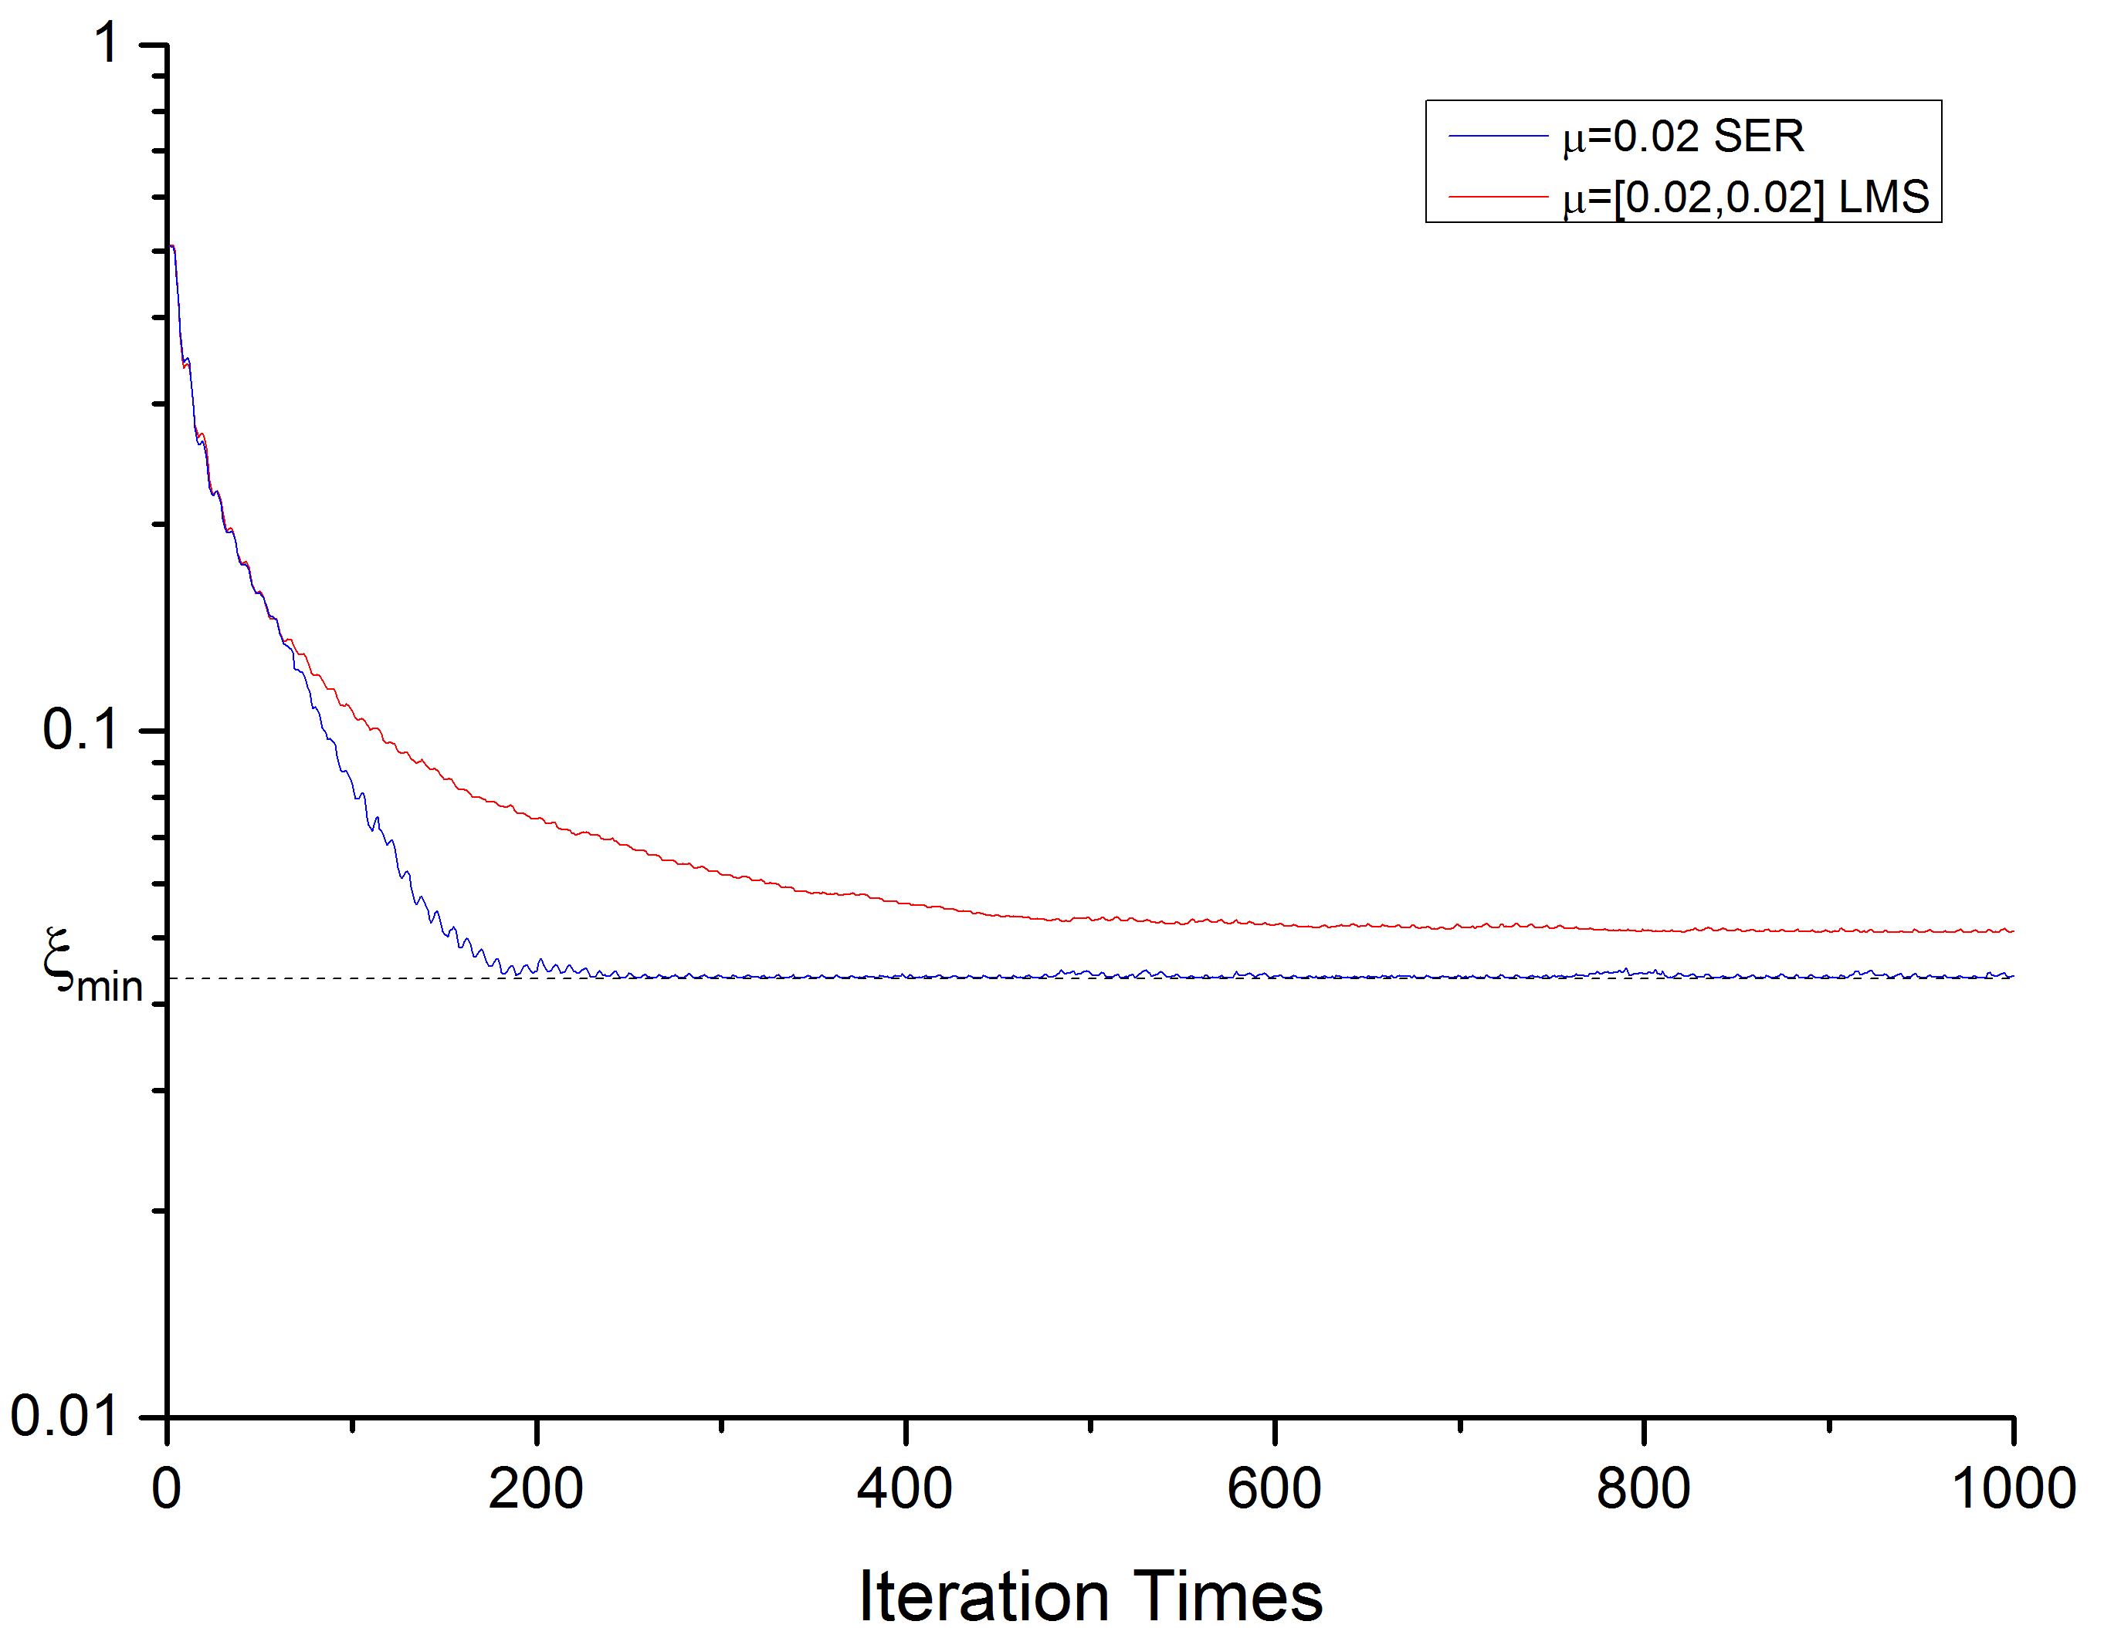
Lattice| Comparisons & Summary
Fig 3-3-2, Learning Curves

Slide 93
Lattice| Comparisons & Summary
We can see the weight track of SER is improved over the track of LMS in same condition. So is the Learning Curves.
However, look closely to these figures.

Slide 94
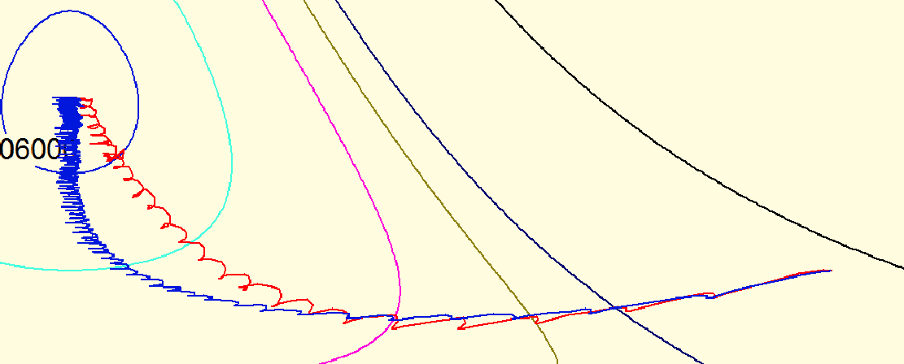
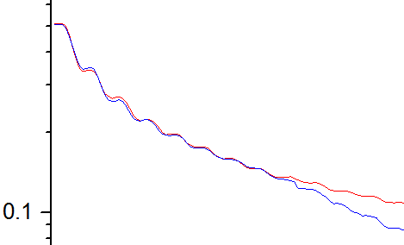
Lattice| Comparisons & Summary
Fig 3-3-3, Detailed figures

Slide 95
CHAP 4 Brief Applications
Adaptive Modeling in FIR Digital Filter Synthesis

Slide 96
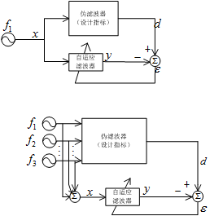
Application| Adaptive Modeling in FIR Digital Filter Synthesis

Slide 97
Application| Adaptive Modeling in FIR Digital Filter Synthesis

Slide 98
Application| Adaptive Modeling in FIR Digital Filter Synthesis
Sometime we want some frequency more close than other, so we introduce cost function.

Slide 99
Application| Adaptive Modeling in FIR Digital Filter Synthesis
Then we can

Slide 100
Application| Adaptive Modeling in FIR Digital Filter Synthesis

Slide 101
Application| Adaptive Modeling in FIR Digital Filter Synthesis
Take these to the function above we can get the and the

Slide 102
Application| Adaptive Modeling in FIR Digital Filter Synthesis
As for the linear phase filter we can arrive

Slide 103
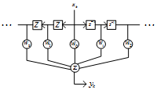
Application| Adaptive Modeling in FIR Digital Filter Synthesis
As we can see , the filter is symmetrical.

Slide 104
Application| Adaptive Modeling in FIR Digital Filter Synthesis
Use LMS algorithm and keep the Symmetric distribution.

Slide 105
CHAP 4 Brief Applications
Adaptive Modeling of Multi-Path Channel

Slide 106
Application| Adaptive Modeling of Multi-Path Channel
Fig 4-2-1, basic architecture of transmitter

Slide 107
Application| Adaptive Modeling of Multi-Path Channel
MultiPath.m
Script
Fig 4-2-2, basic architecture of receiver

Slide 108
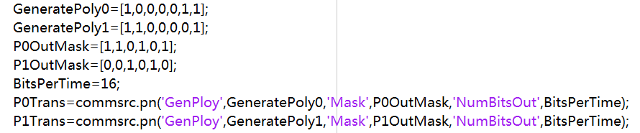
Application| Adaptive Modeling of Multi-Path Channel
Fig 4-2-3, code to create PN sequence object

Slide 109
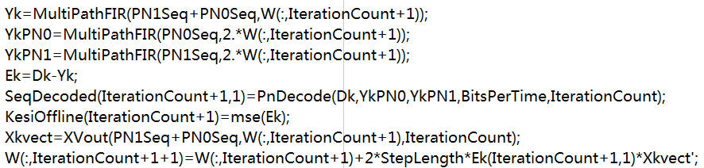
Application| Adaptive Modeling of Multi-Path Channel
Fig 4-2-4, LMS

Slide 110
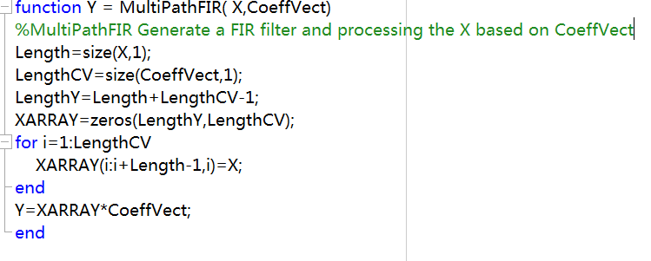
Application| Adaptive Modeling of Multi-Path Channel
Fig 4-2-5, FIR filter to simulate Multi-Path Channel

Slide 111
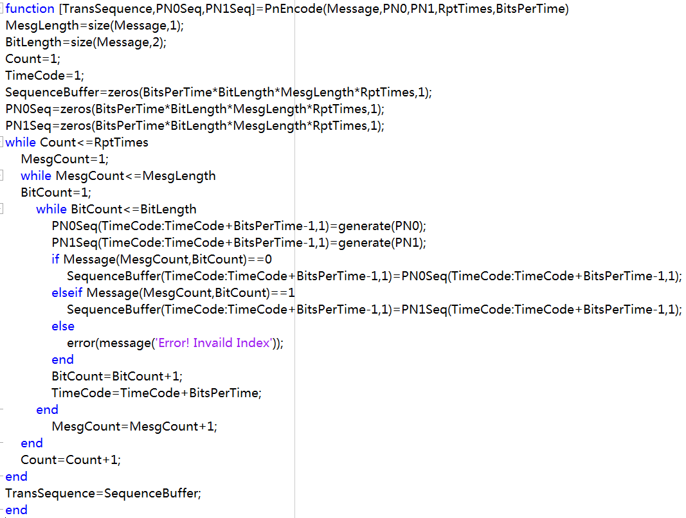
Application| Adaptive Modeling of Multi-Path Channel
Fig 4-2-6, message encoding and sequence modulating function

Slide 112
Application| Adaptive Modeling of Multi-Path Channel
Fig 4-2-6, message encoding and sequence modulating function

Slide 113
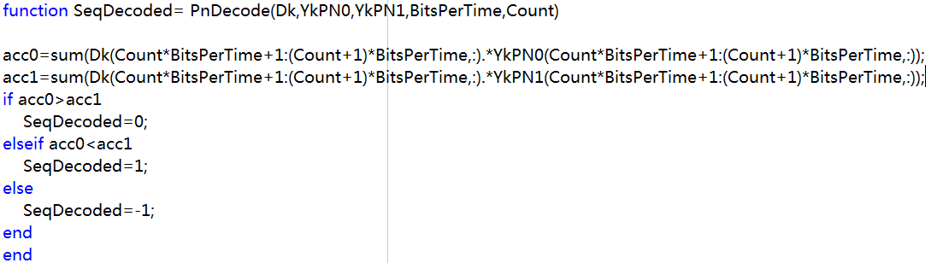
Application| Adaptive Modeling of Multi-Path Channel
Fig 4-2-7, demodulating function

Slide 114
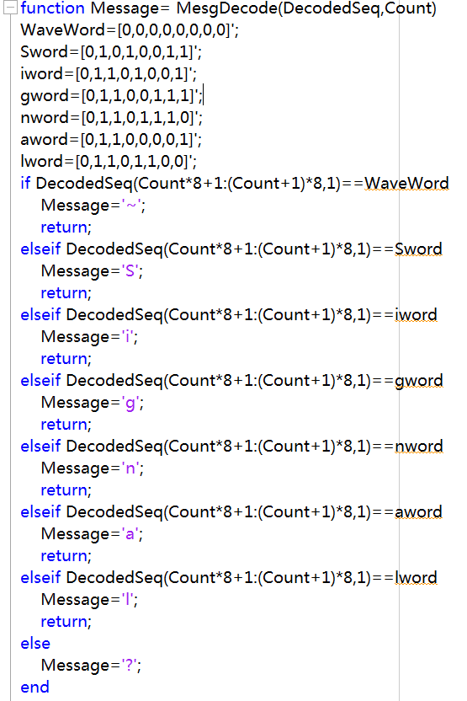
Application| Adaptive Modeling of Multi-Path Channel
Fig 4-2-8, message decoder

Slide 115
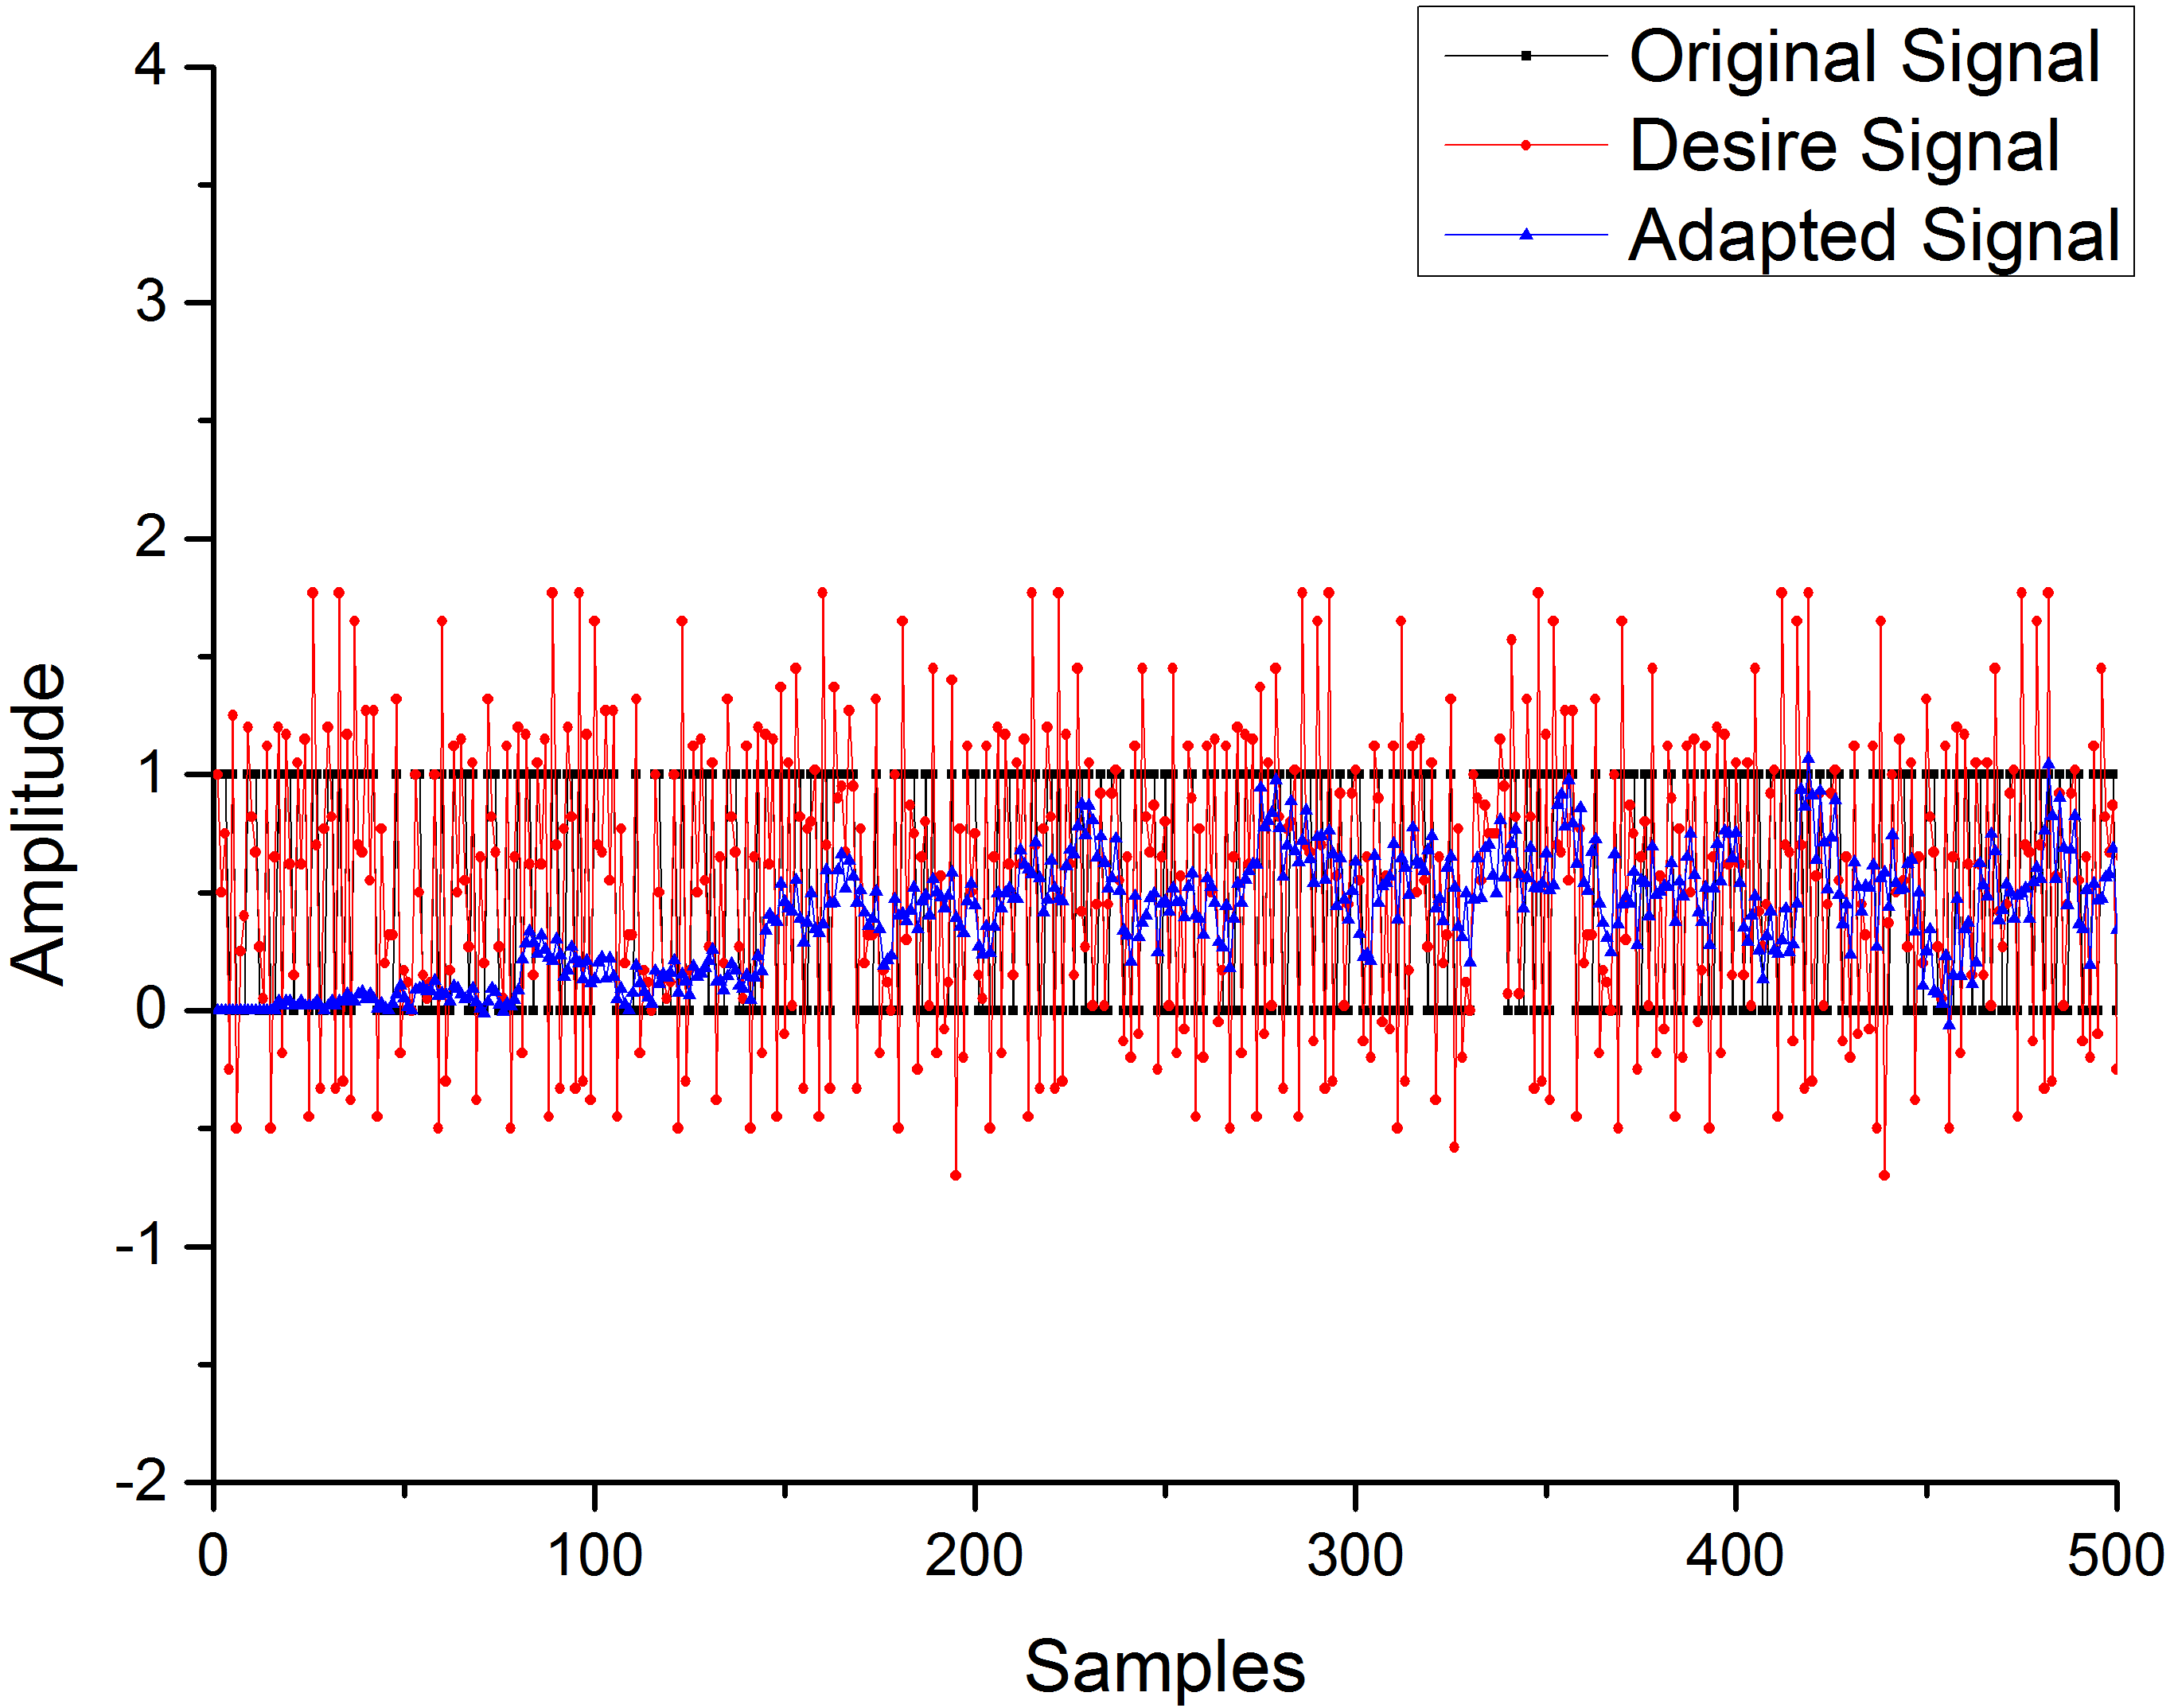
Application| Adaptive Modeling of Multi-Path Channel
Fig 4-2-9, comparison between original sequence, desire signal and adapted signal
In first 500 iterations

Slide 116
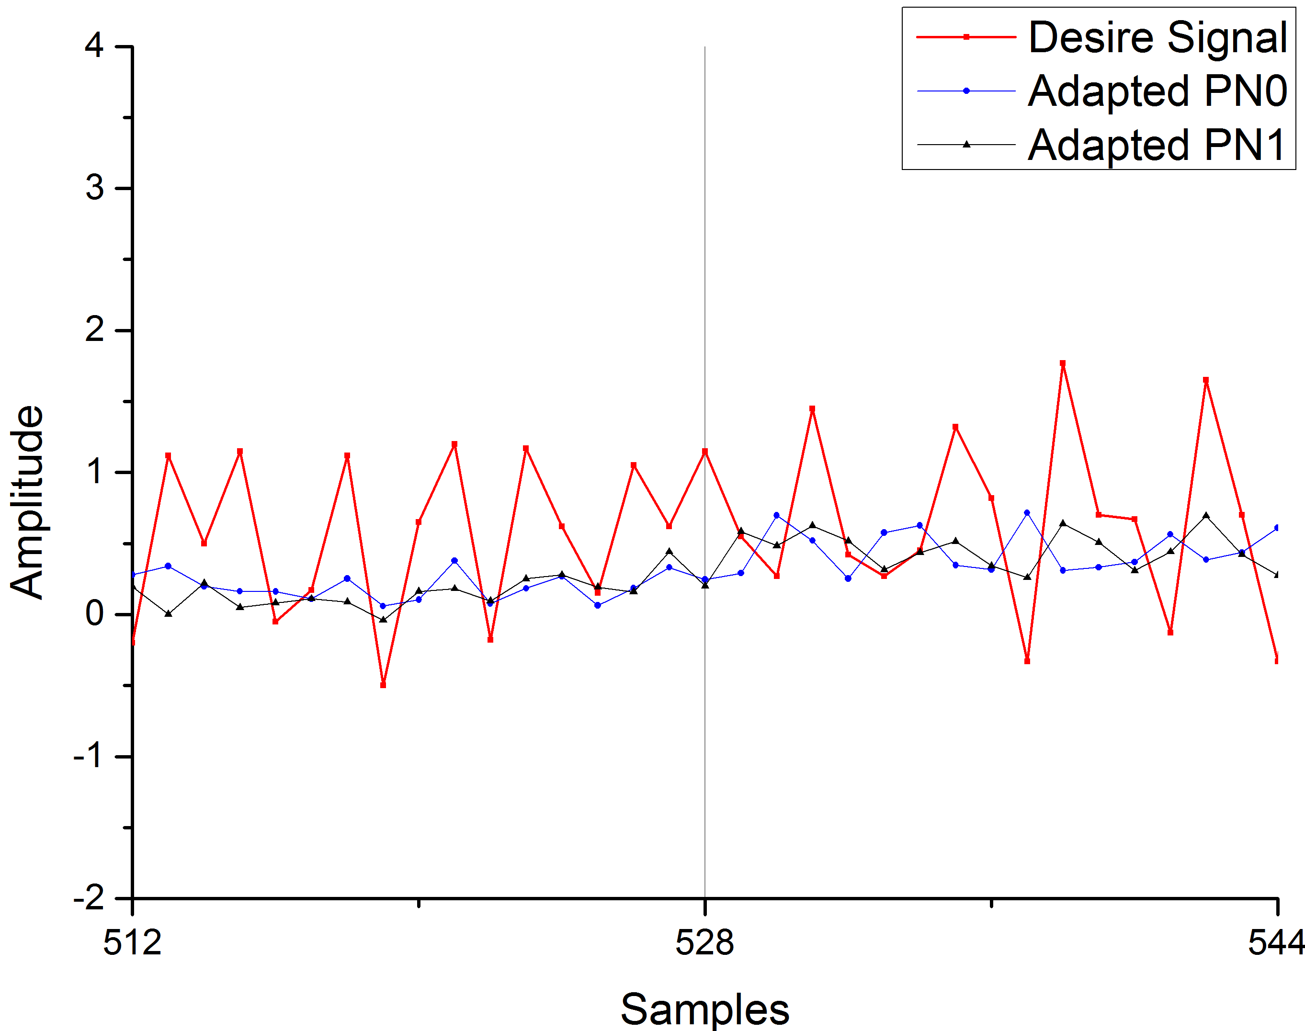
Application| Adaptive Modeling of Multi-Path Channel
Fig 4-2-10, detailed comparison between desire signal, adapted PN0 and adapted PN1
In first 512-544 iterations

Slide 117
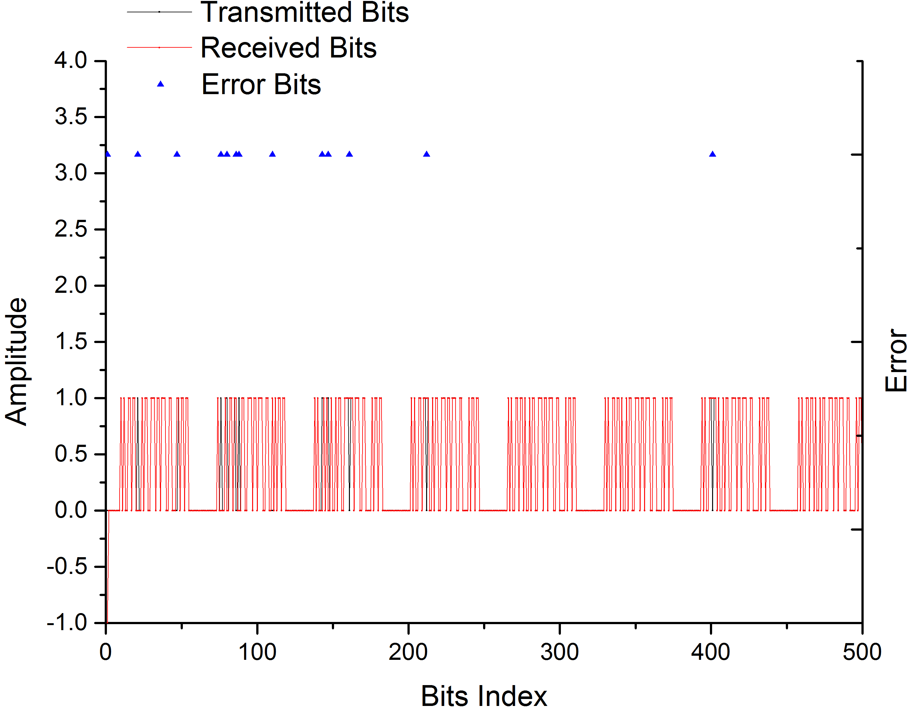
Application| Adaptive Modeling of Multi-Path Channel
Fig 4-2-11, comparison between transmitted bits, received bits and error bits
In first 500 bits

Slide 118
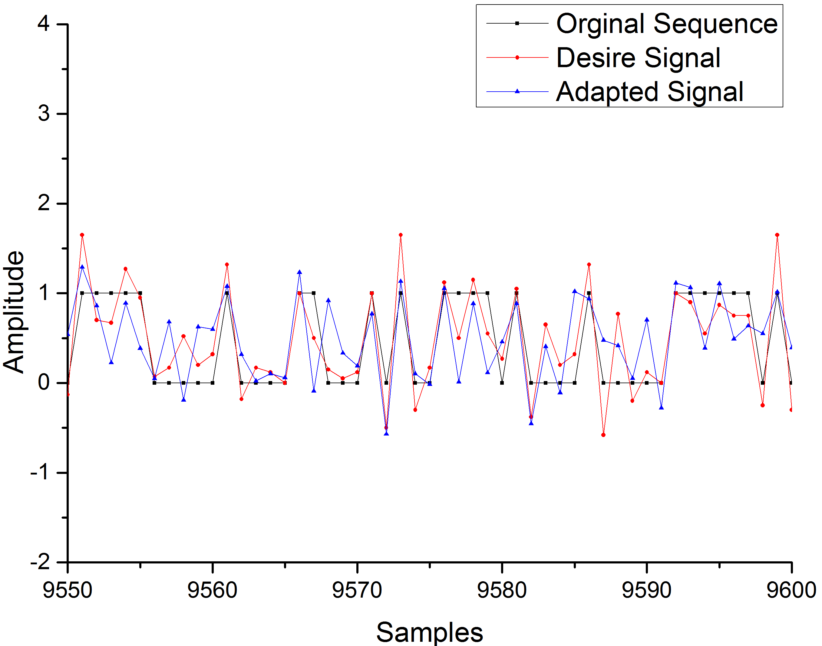
Application| Adaptive Modeling of Multi-Path Channel
Fig 4-2-12, comparison between original sequence, desire signal and adapted signal
In last 9550-9600 iterations

Slide 119

Application| Adaptive Modeling of Multi-Path Channel
Fig 4-2-13, detailed comparison between desire signal, adapted PN0 and adapted PN1
In last 90256-90288 iterations

Slide 120

Application| Adaptive Modeling of Multi-Path Channel
Fig 4-2-14, detailed comparison between transmitted bits, received bits and error bits
In last 600 bits

Slide 121


Application| Adaptive Modeling of Multi-Path Channel
First 10 frames
Last 10 frames
128 error bits in 9600 bits, the rate of error$ε≈1.33\%$
Fig 4-2-15, error bits

Slide 122

Application| Adaptive Modeling of Multi-Path Channel
Fig 4-2-16, learning Curve and Error Bits/500 Samples

Slide 123

Application| Adaptive Modeling of Multi-Path Channel
Fig 4-2-17, brief block figure about this modeling

Slide 124
Application| Adaptive Modeling of Multi-Path Channel
Base on the properties of PN sequence in Matlab
Coherence Function

Slide 125
Application| Adaptive Modeling of Multi-Path Channel

Slide 126
Application| Adaptive Modeling of Multi-Path Channel

Slide 127
Application| Adaptive Modeling of Multi-Path Channel

Slide 128

Application| Adaptive Modeling of Multi-Path Channel
Where $\left.ξ_{min}≈0.191+φ_{r}(0\right)$

Slide 129

Application| Adaptive Modeling of Multi-Path Channel
Fig 4-2-18, learning Curves in different SNR

Slide 130

Application| Adaptive Modeling of Multi-Path Channel
Fig 4-2-19, learning Curves in different SNR

Slide 131

Application| Adaptive Modeling of Multi-Path Channel
Fig 4-2-20, Outputs from slave filters and Dk

Slide 132

Application| Adaptive Modeling of Multi-Path Channel
Fig 4-2-21, Comparison between Original and Optimized

Slide 133

Application| Adaptive Modeling of Multi-Path Channel
After optimization, there’re only 71 error bits, which is nearly reduced by 44.53%, in 9600 bits. The rate of error bits$ε≈0.74\%$
Conclusion:
We could achieve better performance by doubling the coefficients of slave filters in this example.

Slide 134
THE END
Thanks for Your Listening

